Slide 1
Deploying Services (SP2)
Brian Becker
Morten Kromberg

Slide 2
Goals
Give a quick introduction to:
Jarvis – Dyalog's Web Service Framework – to expose APL functions as services
Docker: to create lightweight Virtual Machines known as "Containers"
Docker Compose: to launch and manage multiple inter-connected containers
Amazon Web Services "Elastic Container Service": to allow Docker Compose to launch containers directly to the cloud (so-called "serverless" deployment)
How to scale the system by running multiple copies of selected services
How to assign your own domain name and a certificate to your service

Slide 3
Disclaimer
This workshop covers a lot of material with which we expect most of you will be somewhat unfamiliar. (we learned a lot ourselves in preparing the material 🙂 )
Our intent is to show what is possible and roughly how complicated it is.
Work together through the exercises and don't be afraid to ask questions.
The workshop materials contain a working system which you can continue to work with when you get home.
We plan to follow up with a series of webcasts that will present the material in more "bite-sized" chunks.
We expect the examples and configuration files will continue to evolve and updates will be available on GitHub.
You are welcome to contact us after Dyalog'22 for some free assistance.

Slide 4
The Plan
14:00-15:00 Setting the Scene
Introduction to Jarvis, Docker – and the "Phonebook Service"
Limbering up: running and calling the Service from APL
Building and launching a local Docker container
15:15-16:15 Cloud Storage
Creating a two-tier application in preparation for scaling the system
Introduction to "docker compose"
Building, launching and debugging the two-tier solution
16:30-17:30 Scalable Execution on the Cloud
Installing the Amazon Command Line Interface (CLI)
Launching the application on "Serverless" Amazon Fargate
Wrap up: Using your own domain, and adding a certificate (or not)

Slide 5
The Plan Visualized…

Slide 6
The Plan Visualized…
In the beginning, there was an Application…
Database
App

Slide 7
Run the app as a service
Database
Jarvis
App

Slide 8
Run it in a container
Database
Docker Container
Jarvis
App

Slide 9
Split into Front and Back Ends
We'll call this "Two-Tier"
Database
Front End
Docker Container
Jarvis
Read Operations
App
Write Operations
Docker Container
Jarvis
App
Back End

Slide 10
Try it in the cloud
"The Cloud" (AWS)
Database
Docker Container
Jarvis
Read Operations
App
Write Operations
Docker Container
Jarvis
App

Slide 11
Scale it up
"The Cloud" (AWS)
Database
Docker Container
Jarvis
Read Operations
App
Docker Container
Write Operations
Jarvis
App
Docker Container
Jarvis
Docker Container
App
Jarvis
App

Slide 12
Load balance it
"The Cloud" (AWS)
Database
Docker Container
Jarvis
Read Operations
Load Balancer
App
Docker Container
Write Operations
Jarvis
App
Docker Container
Jarvis
Docker Container
App
Jarvis
App

Slide 13

Secure it
"The Cloud" (AWS)
Database
Docker Container
Jarvis
Read Operations
Load Balancer
App
Docker Container
Write Operations
Jarvis
App
Docker Container
Jarvis
Docker Container
App
Jarvis
App

Slide 14

Check List – Have You…
Installed Docker?
Installed Jarvis?
Downloaded Workshop Materials?
Signed up for an AWS account?
It should cost less than one $/€ to do all the exercises
Around $20 / month if you leave it running
Installed & Configured the AWS Command Line Interface?
How many of you have a domain under your control?
How many of you are on a non-Windows platform?
Apologies, all our automation uses .BAT files
(But real hackers like adapting and running scripts ☺)

Slide 15
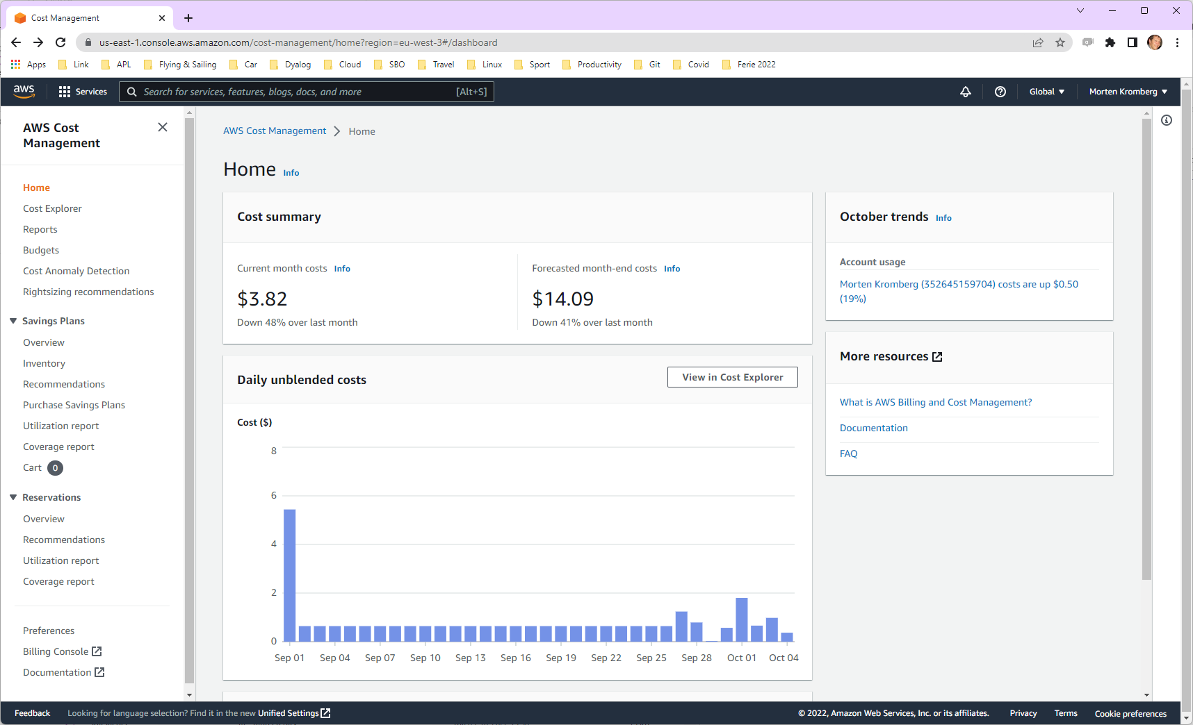

Slide 16
Introducing Jarvis
APL-based web service framework (JSON and REST Service)
Today we'll be using the JSON paradigm
Service "endpoints" are result-returning monadic or dyadic APL functions
All requests are HTTP POST, all payloads are JSON
Jarvis handles the conversion between JSON to APL and back again

Slide 17

Exercise 0 A Web Service in 5 Minutes
⍝ NOTE: All examples assume (⎕IO ⎕ML)←1
⍝ [SP2] is the folder with the SP2 workshop materials
⍝ Start a Dyalog session ]load [SP2]/Jarvis sum←⊃+/ reverse←⌽ Server←⊃Jarvis.Run 8083 # ]open http://localhost:8083 ⍝ Hint: Try [1,2,3,4,5] as input data
Notes:
BPB modified

Slide 18
The Phonebook Application
The database
Two tables – users and phonebook
Stored in .json files (a real app would likely use a DBMS)
Users can edit both tables
Phonebook entry "owners" can edit their own entry
Anyone can read entries

Slide 19
Run the app as a service
Database
Jarvis
App

Slide 20
Exercise 1 Test the Phonebook Application
⍝ [SP2] is the folder with the SP2 workshop materials
⍝ Start a Dyalog session ]load [SP2]/Jarvis Server←Jarvis.New '[SP2]/single-tier/app/jarvis.json' Server.Start ⍝ Start another Dyalog ]load [SP2]/single-tier/HttpCommand HttpCommand.Version ⍝ should be 5.1.5 or later cmd←HttpCommand.New 'post' 'localhost:8080/GetUsers' '""' cmd.Show resp←cmd.Run resp.Data resp←HttpCommand.GetJSON 'post' 'localhost:8080/GetUsers' '' ⎕JSON resp.Data.payload ]open http://localhost:8080
Notes:
BPB modified

Slide 21

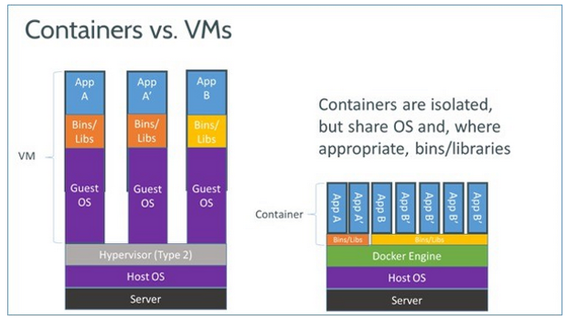
Introduction to Docker
The most widely used container technology are "docker" containers
From: http://www.zdnet.com/article/what-is-docker-and-why-is-it-so-darn-popular/

Slide 22
Efficient and Simple
The really stunning thing is that Docker Containers have a
very simple
text based
description of the contents of a container
... and they start in seconds (at least if they are Linux-based)

Slide 23
A "Dockerfile" describes the Container
Base Image
FROM ubuntu:22.04
ADD ./dyalog-unicode_18.2.nnnnn_amd64.deb / ADD /myapp/v7/test /myapp
RUN dpkg -i /dyalog*.deb RUN git clone https://github.com/dyalog/Jarvis /Jarvis
ENV RIDE_INIT="SERVE:*:4502" ENV CodeLocation=/myapp
CMD dyalog /Jarvis/Distribution/jarvis.dws
Files to Add
Your Code
Run during Build
Environment Vars
Run at Startup
This "Dockerfile" completely describes a machine which will run "myapp".

Slide 24
Building and Running the Docker Image
Dockerfile
FROM ubuntu:22.04
ADD ./dyalog-unicode_18.2.nnnnn_amd64.deb / ADD /myapp/v7/test /myapp
RUN dpkg -i /dyalog*.deb RUN git clone https://github.com/dyalog/Jarvis /Jarvis ENV RIDE_INIT="SERVE:*:4502" ENV CodeLocation=/myapp
CMD dyalog /Jarvis/Distribution/jarvis.dws
Build
docker build –t myco/myapp-test .
Run
docker run -p 8081:8080 -v /somefolder:/data –e DEBUG=1 myco/myapp-test

Slide 25
docker run syntax & common switches
docker run [OPTIONS] IMAGE [COMMAND] [ARG...]
docker run -p 8081:8080 -v /somefolder:/data –e DEBUG=1 myco/myapp-test
Switch | Description
-p hhhh:cccc | Make TCP port cccc in container visible on the host as hhhh
-e name=value | Set environment variable inside the container
-v /hfolder:/cfolder | Mount /hfolder in container as /cfolder NB Under Windows, /hfolder must be a full pathname using Windows conventions (C:\...)
--rm | Discard changes when container terminates

Slide 26

Container Distribution
DockerHub is to Docker as GitHub is to Git
A public repository of container images
Unlimited public images for free
You can store one free private image
You can install private servers "in house"
Today, we will use Amazon Elastic Container Registry
ECR is a repository integrated with Amazon Web Services

Slide 27
Distributing the Image via DockerHub
Build
docker build –t myco/myapp-test .
We can "push" the image to DockerHub:
You need an account
Push
docker login
docker push myco/myapp-test
Now, the following will work on ANY computer that has Docker installed (no explicit "docker pull" is required)
Run
docker run -p 8081:8080 -v /somefolder:/data –e DEBUG=1 myco/myapp-test

Slide 28
Public Dyalog Images
Image | Description
dyalog/dyalog | Just Dyalog APL
dyalog/jarvis | Dyalog APL + Jarvis
dyalog/miserver | Dyalog APL + MiServer
dyalog/jupyter | Dyalog APL + Jupyter Notebook framework
NB all public images assume/provide you have a basic Dyalog licence.
docker run -p 8081:8080 -v /my/web/service:/app dyalog/jarvis

Slide 29
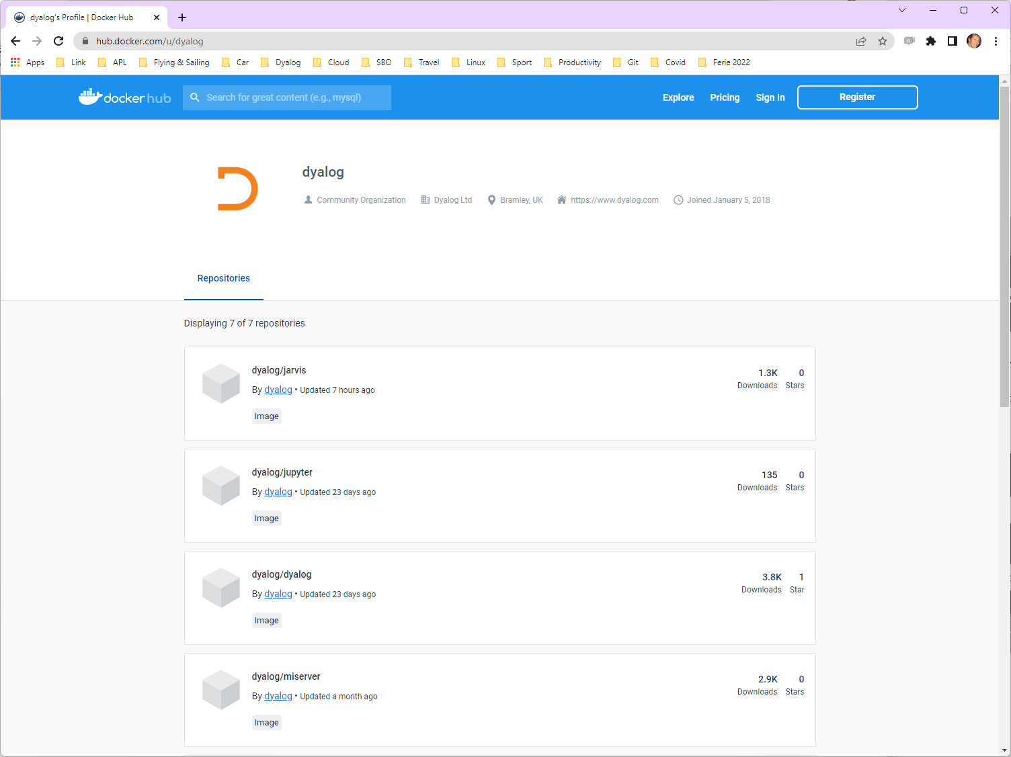

Slide 30
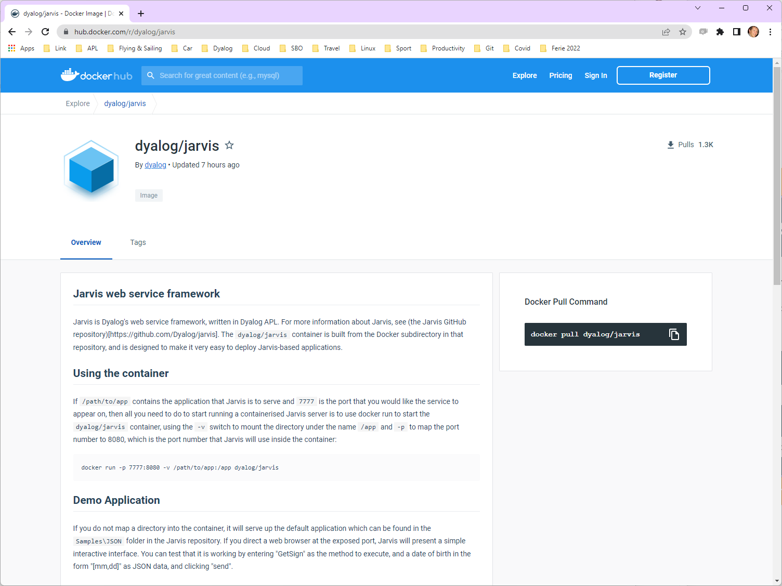

Slide 31
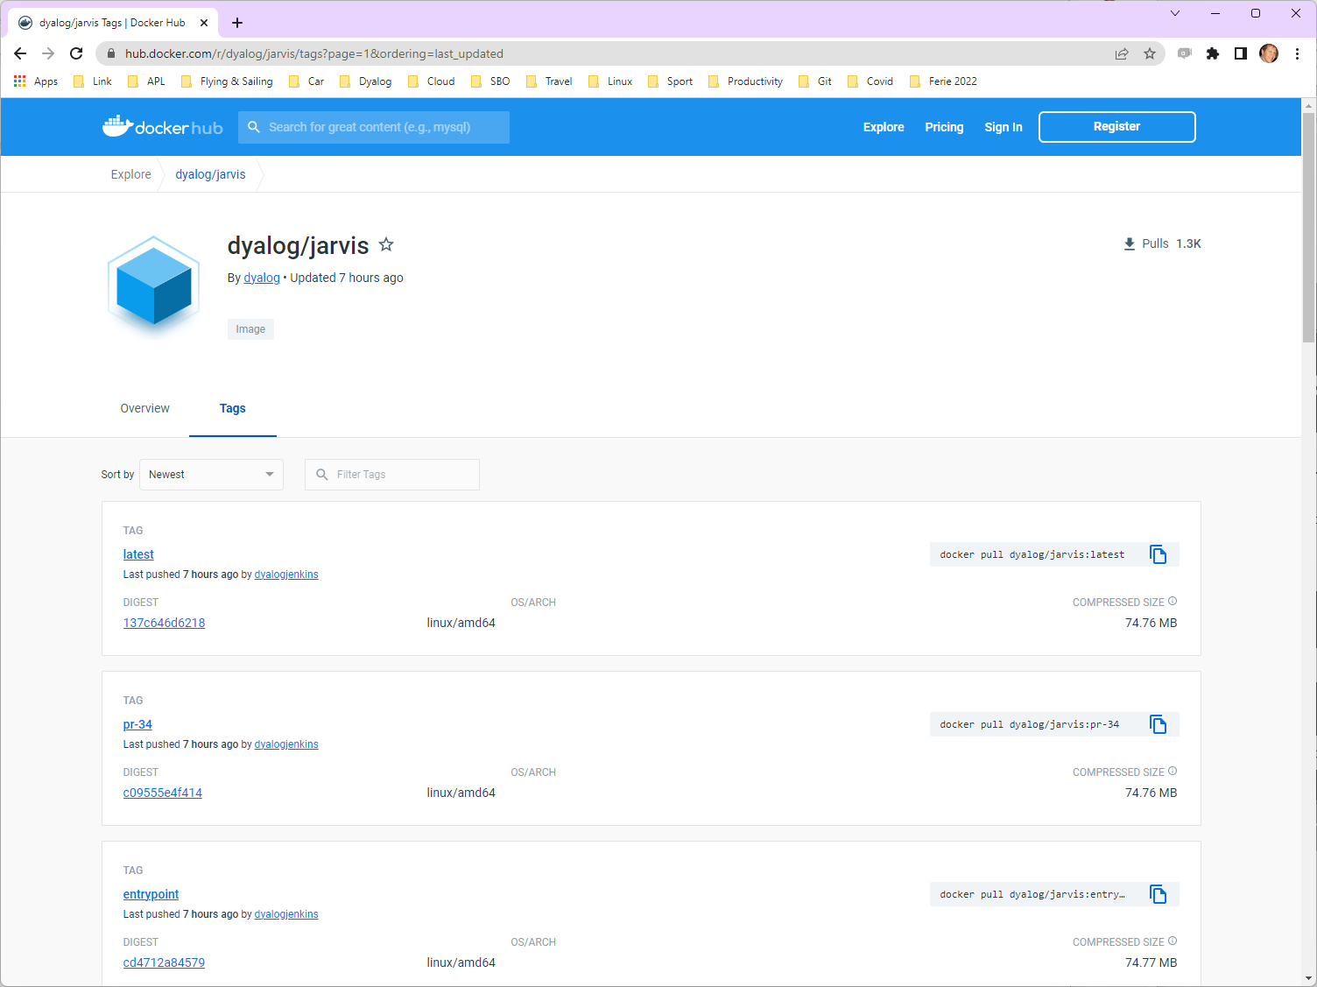

Slide 32
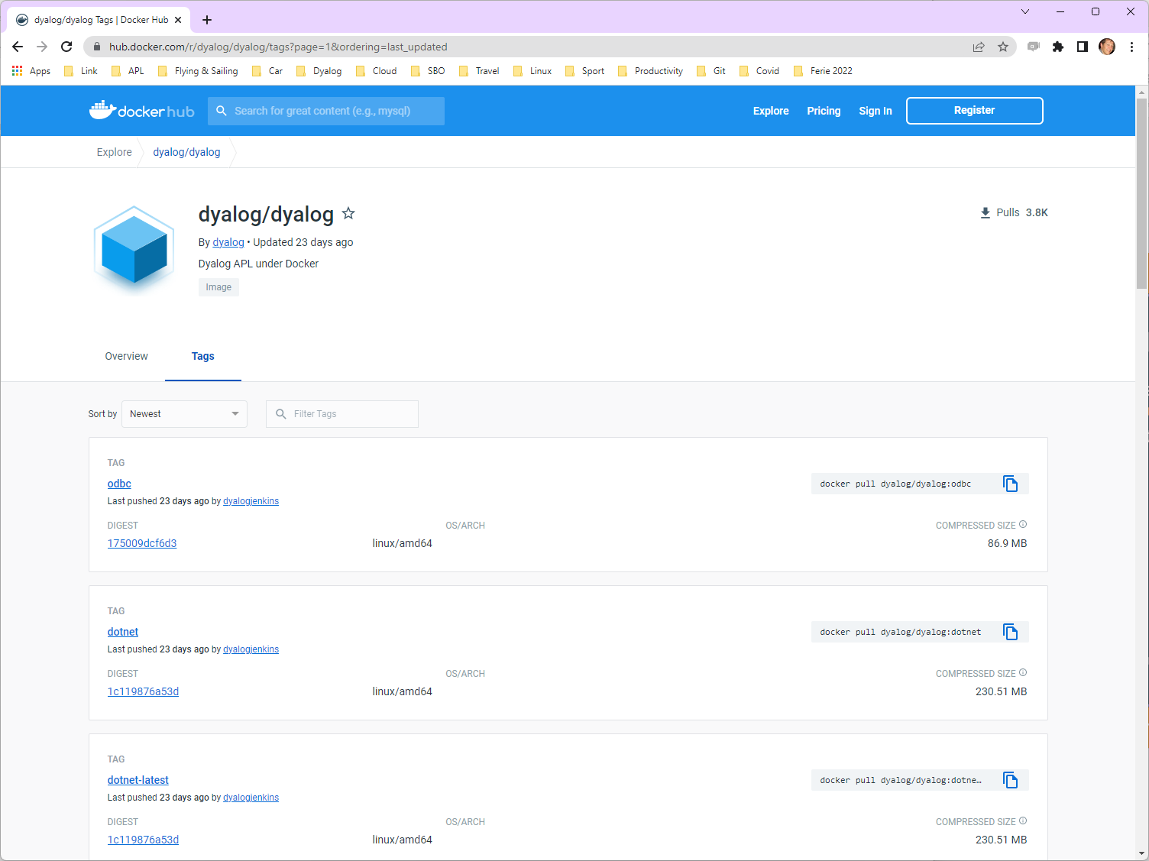

Slide 33
Typical Switches settings when using public Dyalog Images
Switch | Description
-p 80:8080 | Expose default Jarvis/MiServer port as port 80
-e RIDE_INIT=HTTP:*:8088 | Enable "Zero Footprint" RIDE on port 8088
-p 8088:8088 | Expose port 8088 to the outside world
-v /my/web/service:/app | Mount /my/web/service in container as /app
docker run -p 8081:8080 -v /somefolder:/app dyalog/jarvis:latest

Slide 34

Benefits of Public Containers
Without Public Containers
FROM ubuntu:22.04 ADD ./dyalog-unicode_18.2.nnnnn_amd64.deb / RUN dpkg -i /dyalog*.deb RUN git clone https://github.com/dyalog/Jarvis /Jarvis ADD /myapp/v7/test /app CMD dyalog /Jarvis/Distribution/jarvis.dws
With Public Containers
FROM dyalog/jarvis
ADD /myapp/v7/test /app
Or without building a container at all
docker run –p 8080:8080 –v /myapp/v7/test:/app dyalog/jarvis

Slide 35

Warning: Public Containers
The public containers are for experimentation and prototyping
For production use, you should build your own container
Otherwise, the version of the interpreter or Jarvis might change under your feet

Slide 36
Run it in a container
Database
Docker Container
Jarvis
App

Slide 37
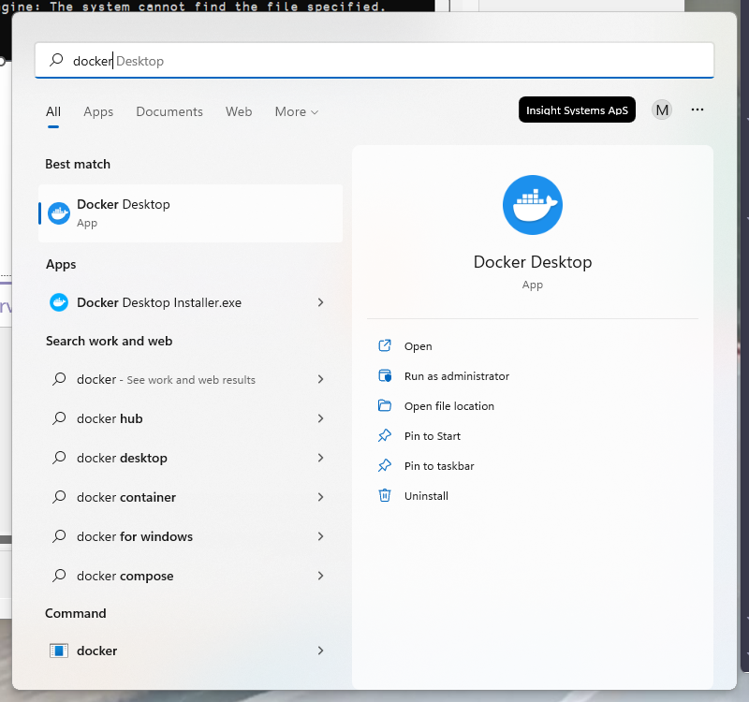
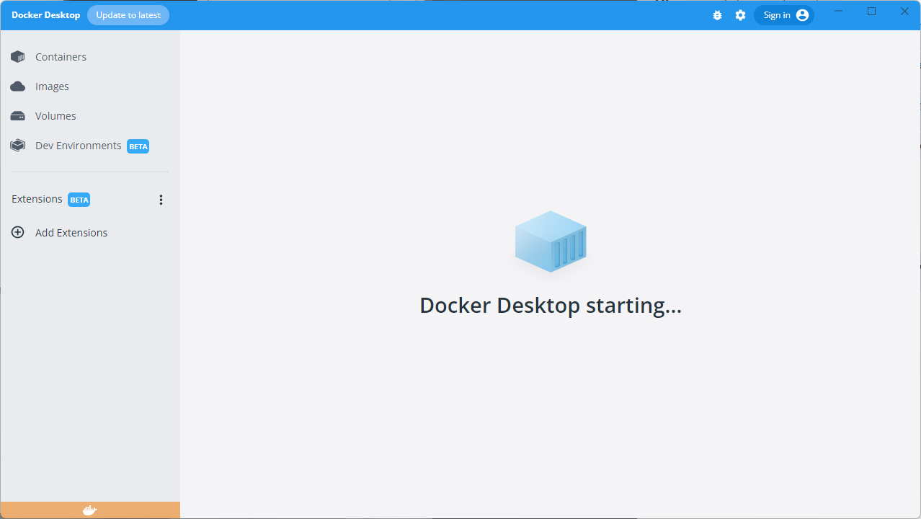

Slide 38
Exercise 2 Running Phonebook in Docker
Start Docker / Docker Desktop
Build & start docker container
Make a request
Debug with RIDE
Hint: See build.bat and start-local.bat in the single-tier folder

Slide 39
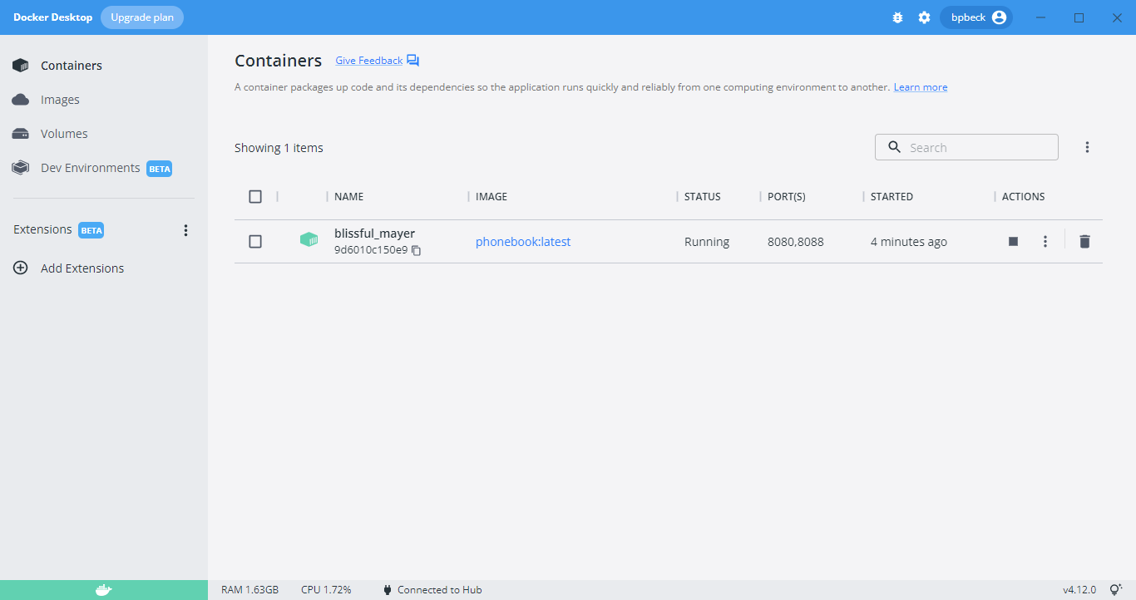
Putting a stop to things using Docker Desktop

Slide 40
Putting a stop to things using Docker Desktop

Slide 41
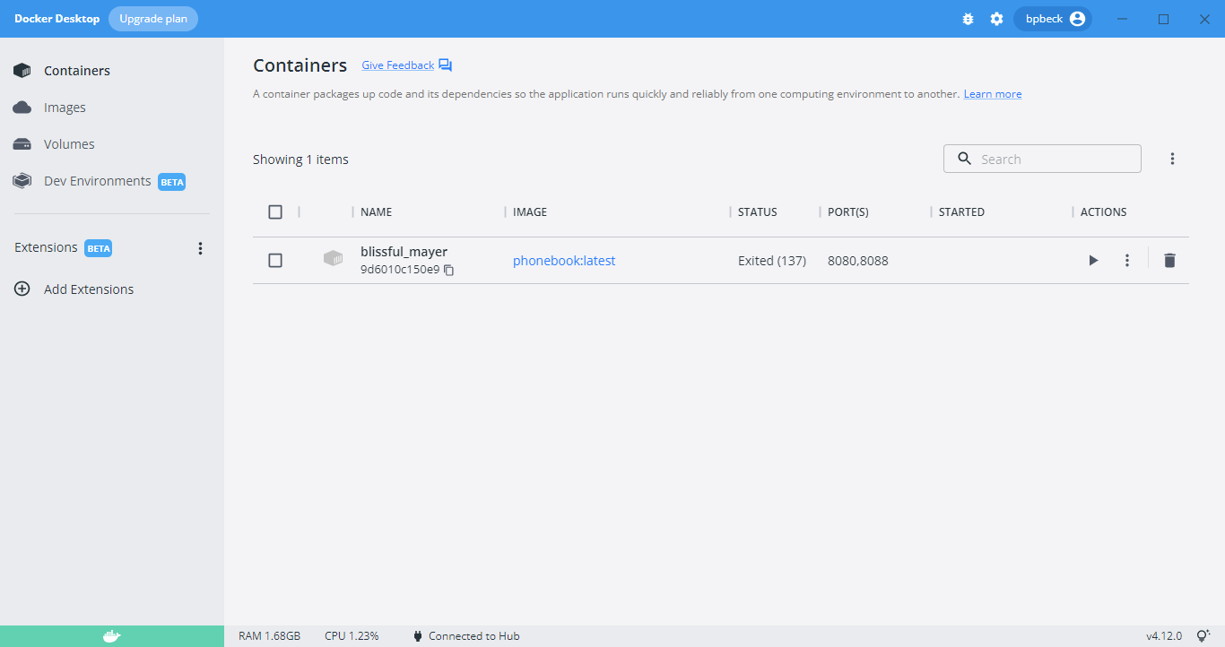
Putting a stop to things using Docker Desktop

Slide 42
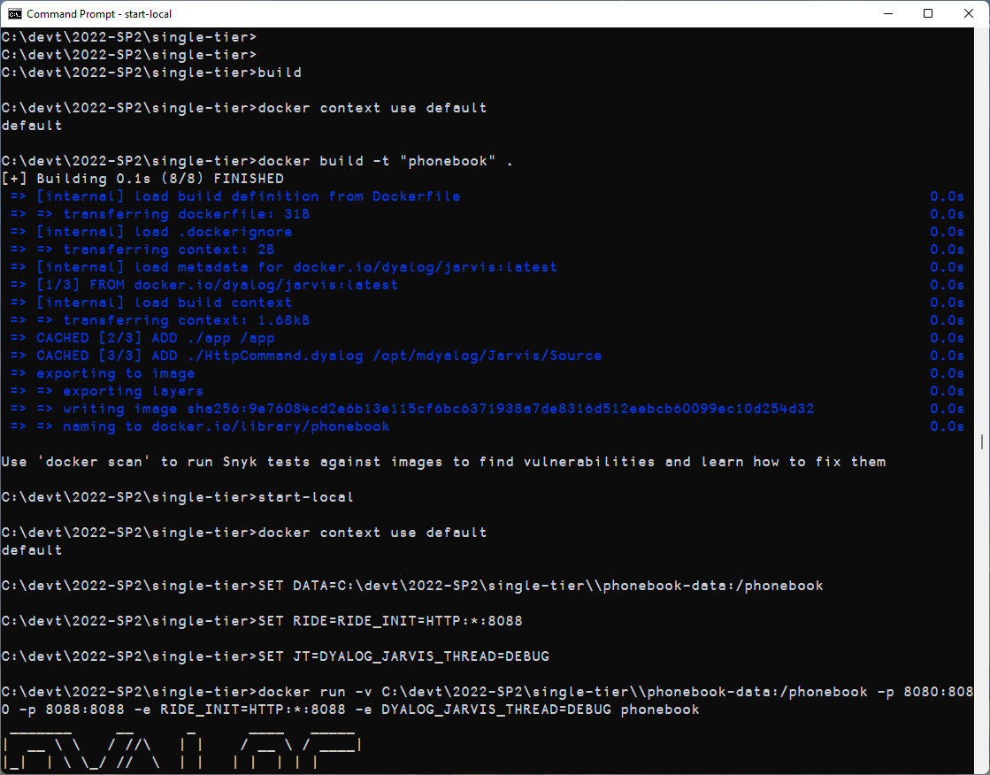

Slide 43
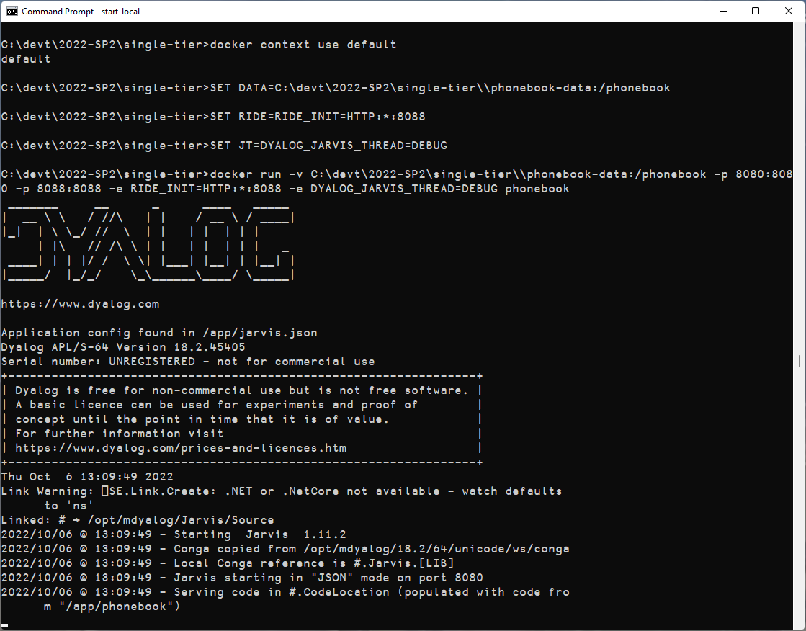
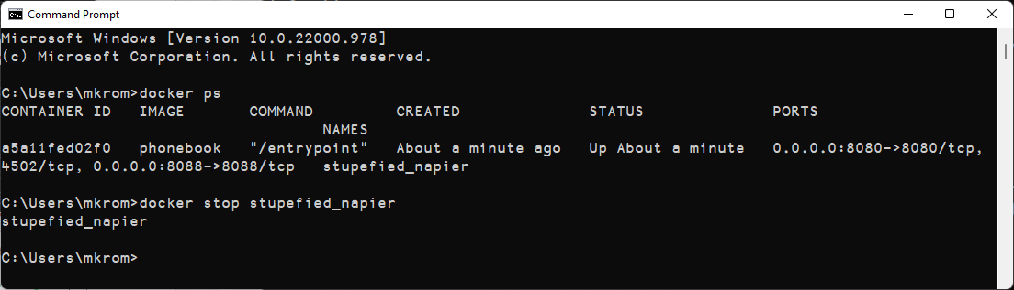

Slide 44
Split into Front and Back Ends
We'll call this "Two-Tier"
Database
Front End
Docker Container
Jarvis
Read Operations
App
Write Operations
Docker Container
Jarvis
App
Back End

Slide 45
Two-Tier Phonebook
Front-End
Read-only endpoints read directly from database
Requests for endpoints that write to the database are relayed to the Back-End
All authentication and validation of payloads is done in the front end
Back-End
Endpoints do no authentication or payload validation
All endpoints return an namespace with
rc – return code: 0 means "no error"
msg – informational message if applicable
payload – response payload, if any

Slide 46
∇ resp←req AddUser ns;user;rc;msg;users [1] →end⍴⍨0≠(resp←ns utils.checkPayload'"login' '"password').rc [2] resp←utils.initializeResponse [3] [4] :Hold 'database' [5] :If 0≠⊃(rc msg users)←dbapi.readUsers [6] →end⊣resp.(rc msg)←rc msg [7] :EndIf [8] [9] :If 0≠users.login utils.indexOf⊆,ns.login [10] →fail⊣resp.(rc msg)←400('user ',ns.login,' already exists') [11] :EndIf [12] [13] ns.password←utils.hashPassword ns.password [14] ns.updatedAt←utils.now [15] users,←ns [16] →end⍴⍨0≠(resp←dbapi.writeUsers users).rc [17] [18] resp.(rc msg)←0('user ',ns.login,' added') [19] :EndHold [20] →0 [21] end: [22] :If 0≠resp.rc ⋄ req.Fail resp.rc ⋄ :EndIf ∇
Single-Tier

Slide 47
∇ resp←req AddUser ns;user;rc;msg;users [1] →end⍴⍨0≠(resp←ns utils.checkPayload'"login' '"password').rc [2] resp←req utils.callBackEnd ns [3] end: [4] :If 0≠resp.rc ⋄ req.Fail resp.rc ⋄ :EndIf ∇
Two-Tier
Back End
Front End
∇ resp←req AddUser ns;user;rc;msg;users [1] resp←utils.initializeResponse [2] [3] :Hold 'database' [4] :If 0≠⊃(rc msg users)←dbapi.readUsers [5] →end⊣resp.(rc msg)←rc msg [6] :EndIf [7] [8] :If 0≠users.login utils.indexOf⊆,ns.login [9] →fail⊣resp.(rc msg)←400('user ',ns.login,' already exists') [10] :EndIf [11] [12] ns.password←utils.hashPassword ns.password [13] ns.updatedAt←utils.now [14] users,←ns [15] →end⍴⍨0≠(resp←dbapi.writeUsers users).rc [16] [17] resp.(rc msg)←0('user ',ns.login,' added') [18] :EndHold [19] →0 [20] end: [21] :If 0≠resp.rc ⋄ req.Fail resp.rc ⋄ :EndIf ∇
∇ resp←req callBackEnd ns;r [1] ⍝ sends a call to the backend endpoint [2] :Trap 0 [3] r←HttpCommand.GetJSON'post'('backend:8081',req.Endpoint)ns [4] :If r.rc=0 [5] :AndIf r.HttpStatus=200 [6] resp←r.Data [7] →0 [8] :EndIf [9] :EndTrap [10] resp←initializeResponse [11] resp.(rc msg)←500('back end call failed') [12] req.Fail 500 ∇

Slide 48
Introduction to Docker Compose

Slide 49
Collaborating Containers with Docker-Compose
Docker-Compose is a tool for orchestrating container images that need to work together.
It creates a Virtual IP network that connects related images together so they can refer to each other by name.
In our case, "frontend" and "backend"
It also supports replication of images and load balancing
We will wait with that until we deploy to the cloud

Slide 50
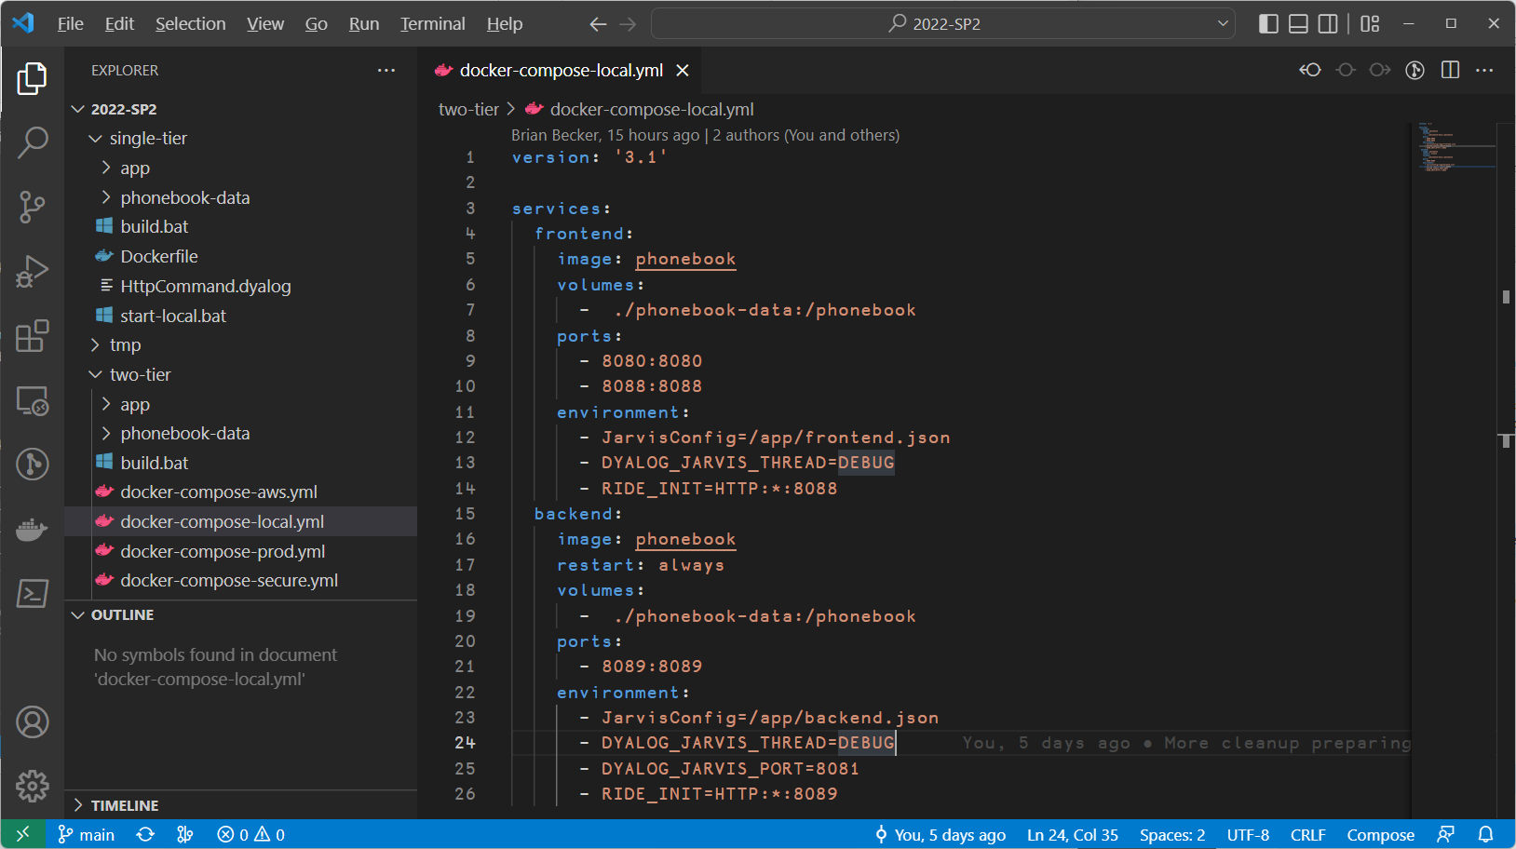
Shared Docker Image
Notes:
BPB update screenshot

Slide 51
Shared Data

Slide 52
Different config files

Slide 53
Frontend Exposed on Port 8080
RIDE exposed on 8088 (front)
8089 (back)
Backend on port 8081 visible to frontend, but not exposed
Notes:
BPB update screenshot

Slide 54
Our first "docker compose"
We will issue the command:
docker compose –p phonebook –f docker-compose-local.aws up -p: Sets the project name. It is important to use this each time so your commands apply to the same stack. If you forget, it may start or stop the wrong stack (default is the current folder name).
-f: selects the docker-compose file (defaults to docker-compose.yml)
DO NOT forget –p and –f each time or you will regret it!

Slide 55
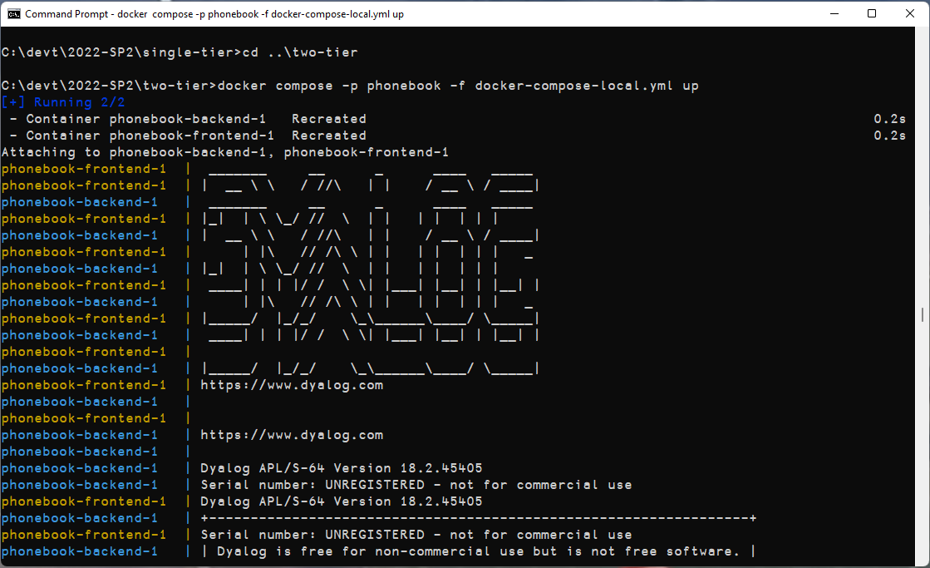

Slide 56
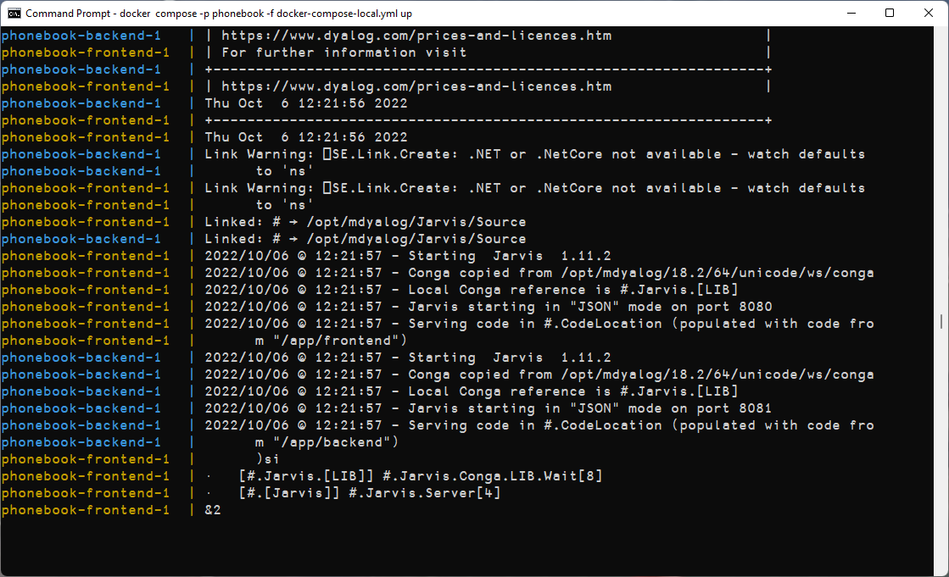
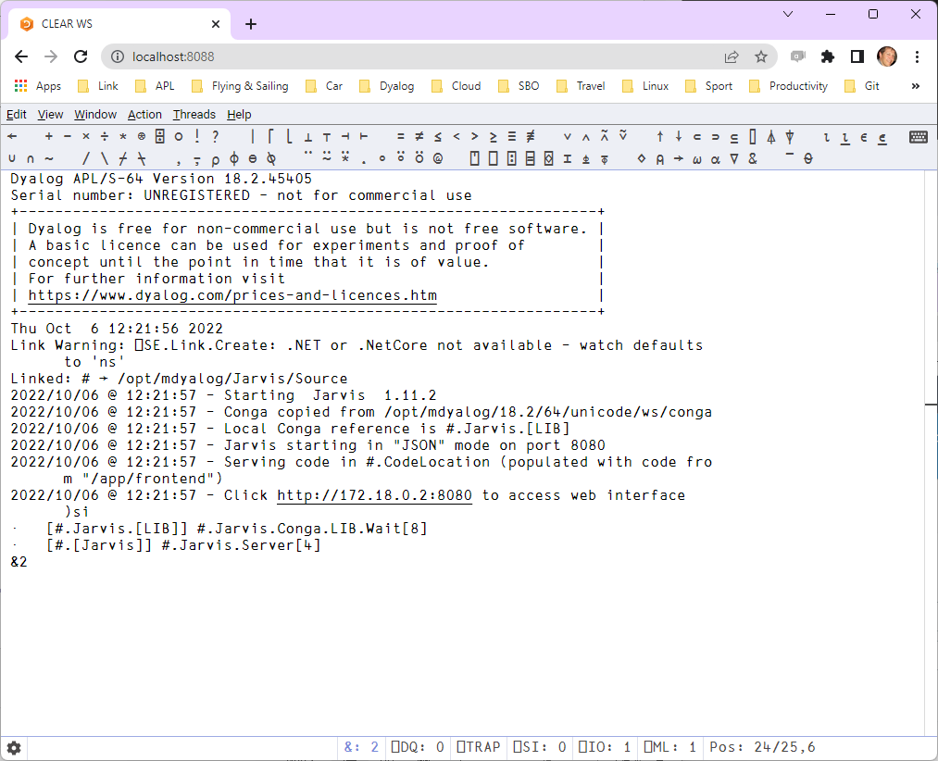
Notes:
BPB update screenshot

Slide 57
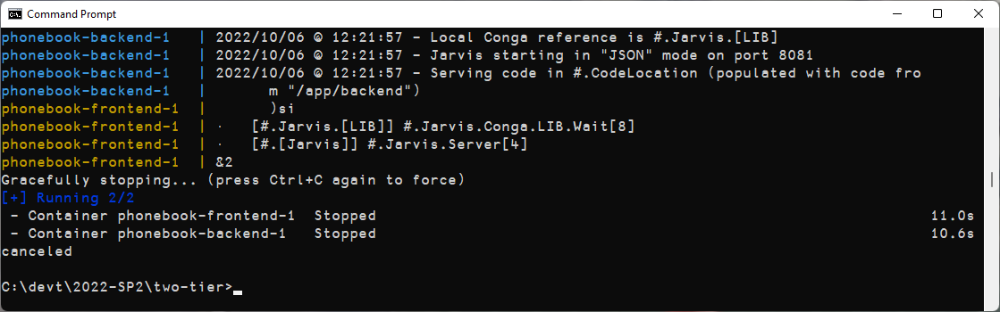
Ctrl-C to stop

Slide 58
Split into Front and Back Ends
We'll call this "Two-Tier"
Database
Front End
Docker Container
Jarvis
Read Operations
App
Write Operations
Docker Compose
defines the containers
that make up a service
Docker Container
Jarvis
App
Back End

Slide 59
Exercise 3 Local Docker Compose
Start docker desktop
Do a "docker compose up" using -f docker-compose-local.yml To select the right docker-compose file
Make a request
Debug with RIDE
Advanced: Check that you can make a request to backend:8081 from a RIDE session to the frontend, but NOT from the outside (port 8081)
See what happens if you )OFF from RIDE

Slide 60

Head for the Clouds

Slide 61
Try it in the cloud
"The Cloud" (AWS)
Database
Docker Container
Jarvis
Read Operations
App
Write Operations
Docker Container
Jarvis
App

Slide 62
AWS Configuration
Create AWS user (you should have done this already)
NB: We recommend and have been testing with eu-west-3 (Paris) as the default region
Create IAM user
Download credentials / tokens
Install AWS CLI & configure to use tokens
Push images to Amazon Container Registry

Slide 63
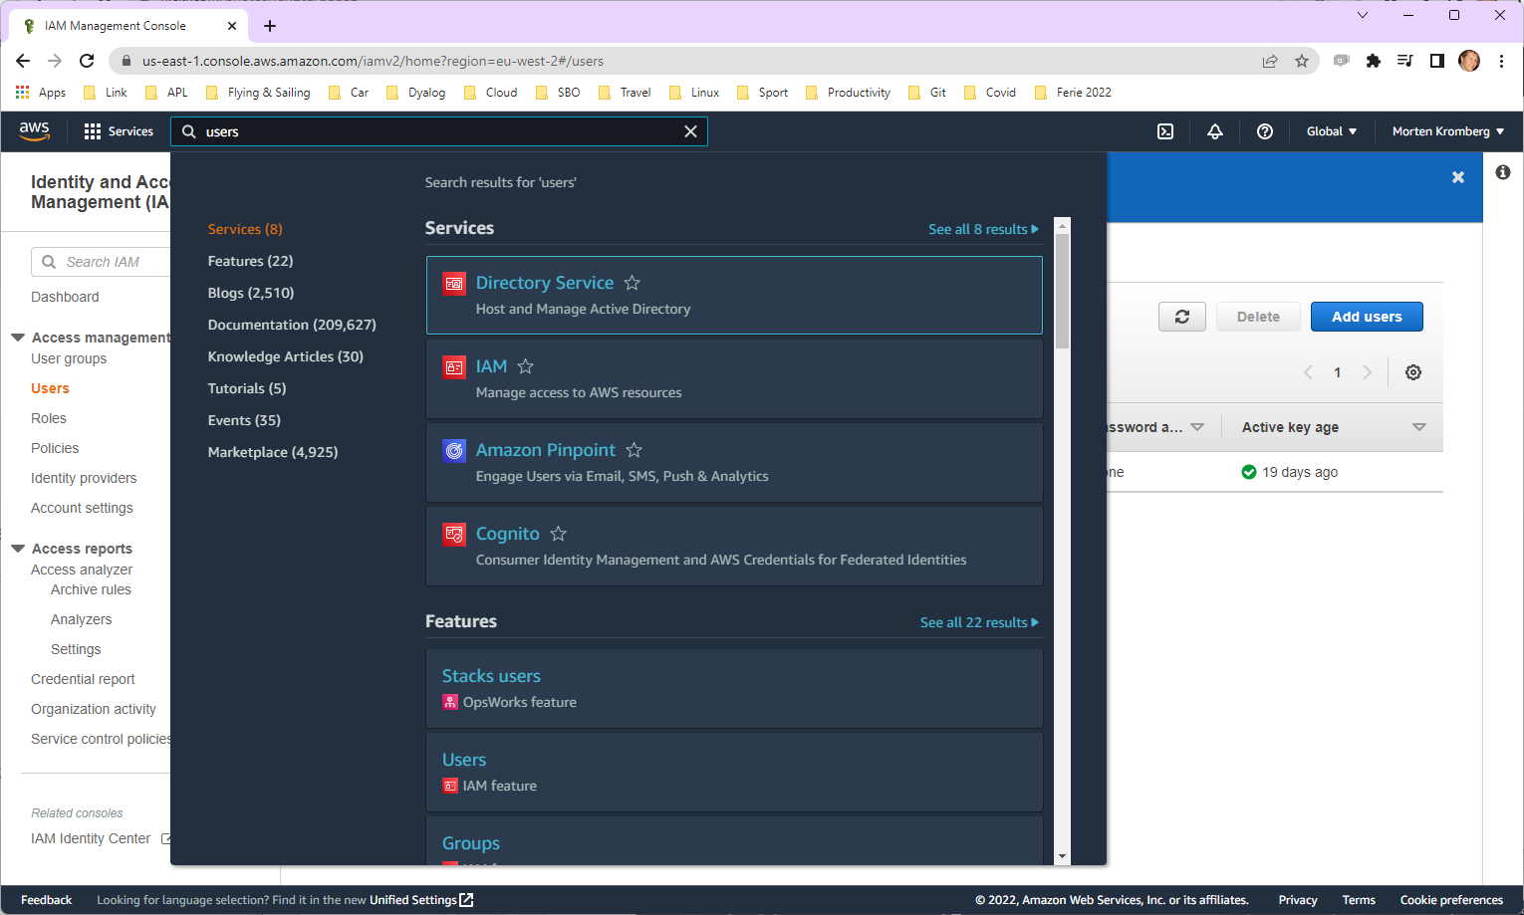

Slide 64
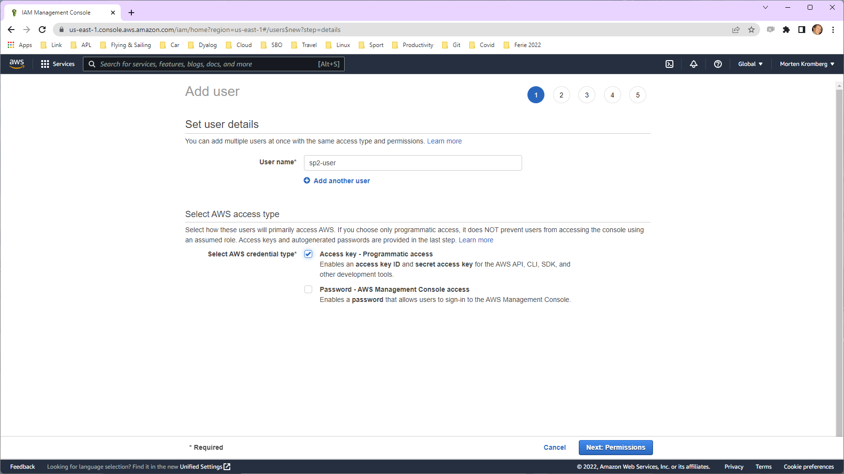

Slide 65
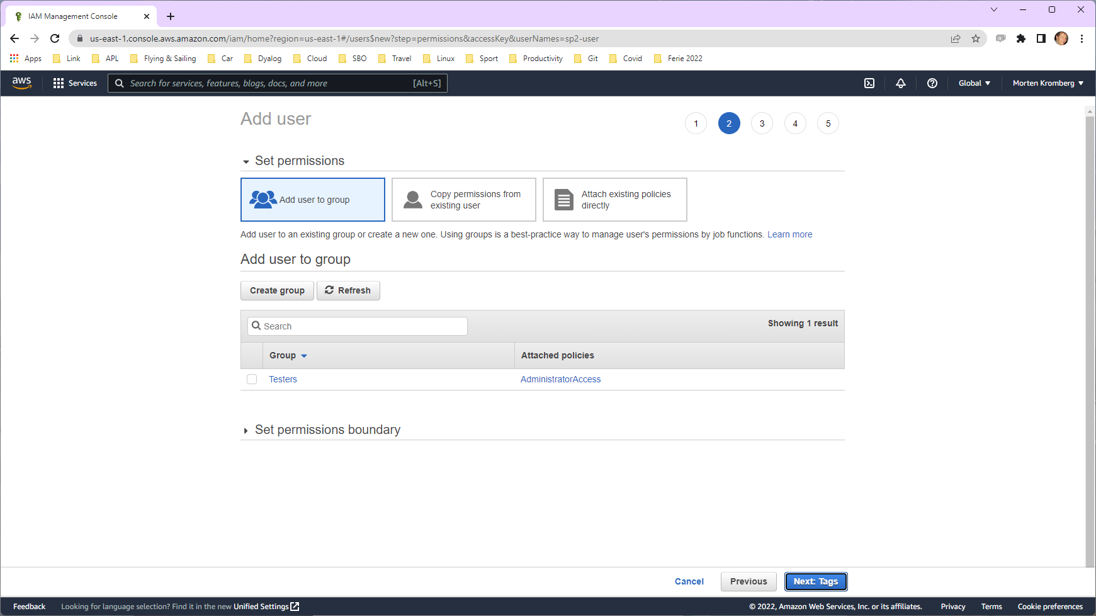

Slide 66
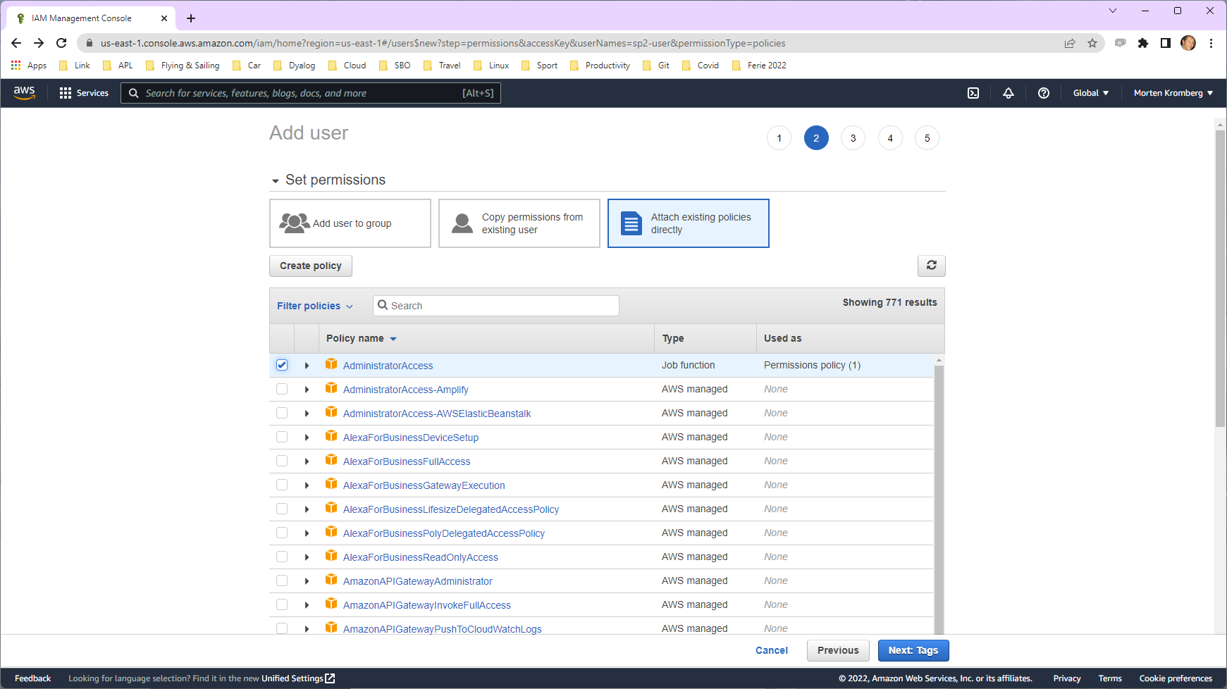

Slide 67
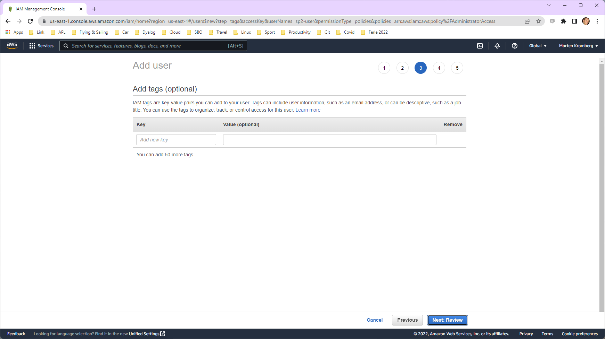

Slide 68
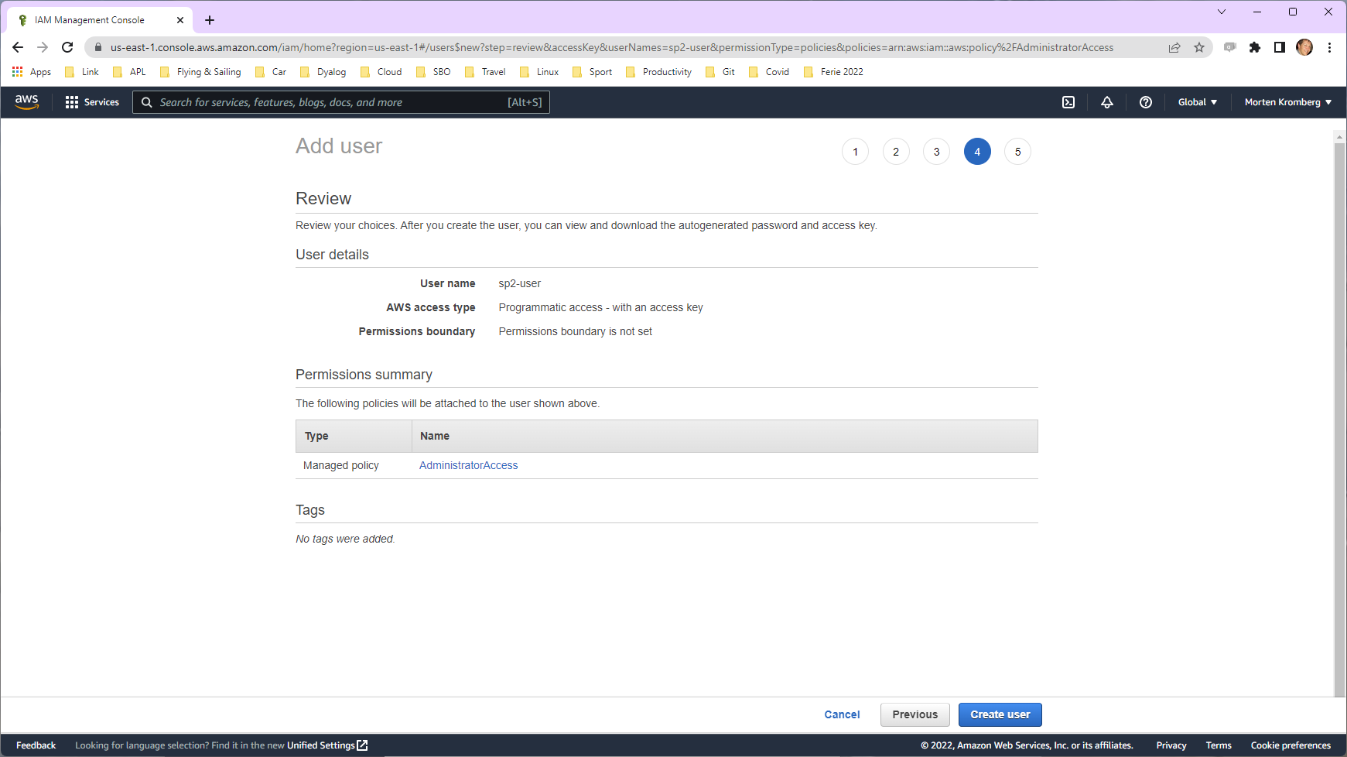

Slide 69
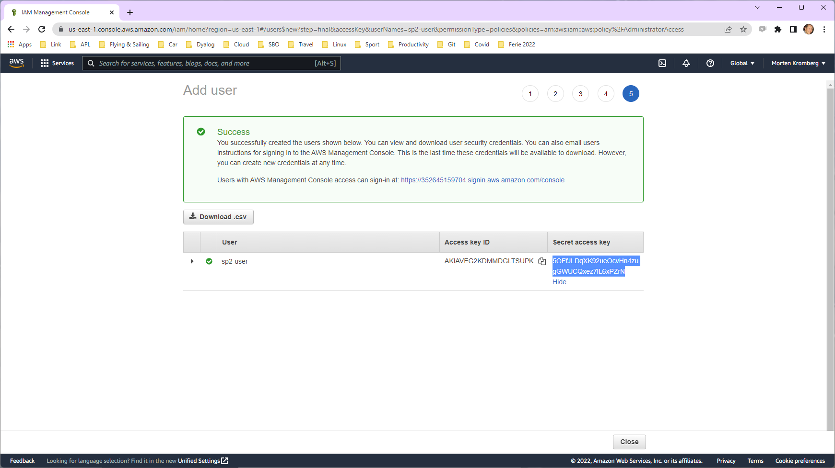

Slide 70
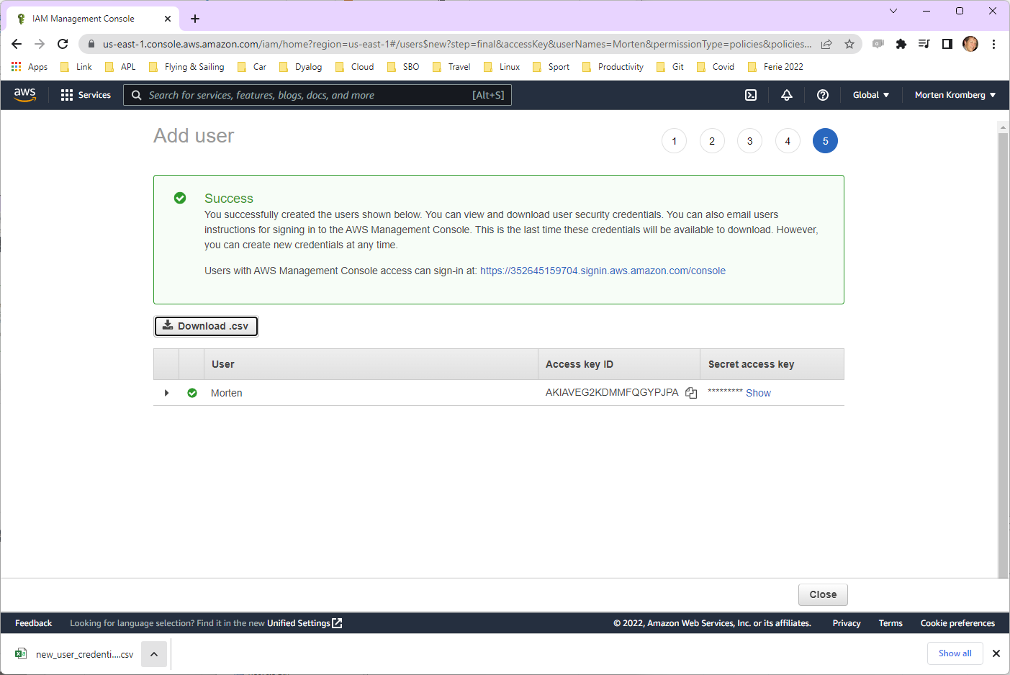

Slide 71
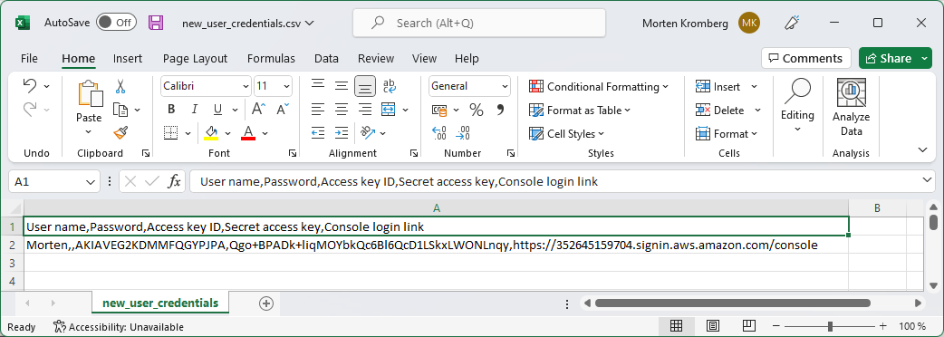
(these credentials are no longer valid ☺)

Slide 72
AWS CLI Setup
We need to:
Install the Amazon Web Services Command Line Interface
Configure it to use our new User Credentials

Slide 73
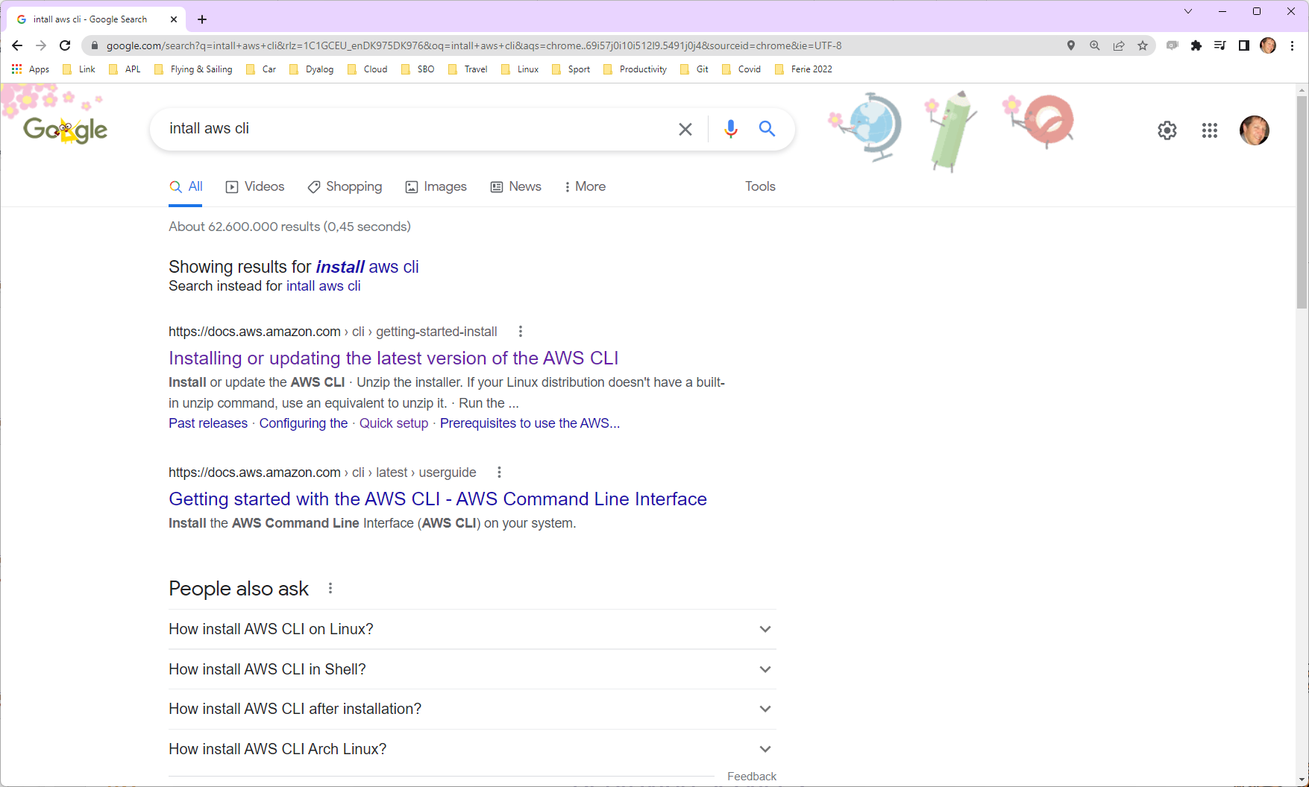

Slide 74
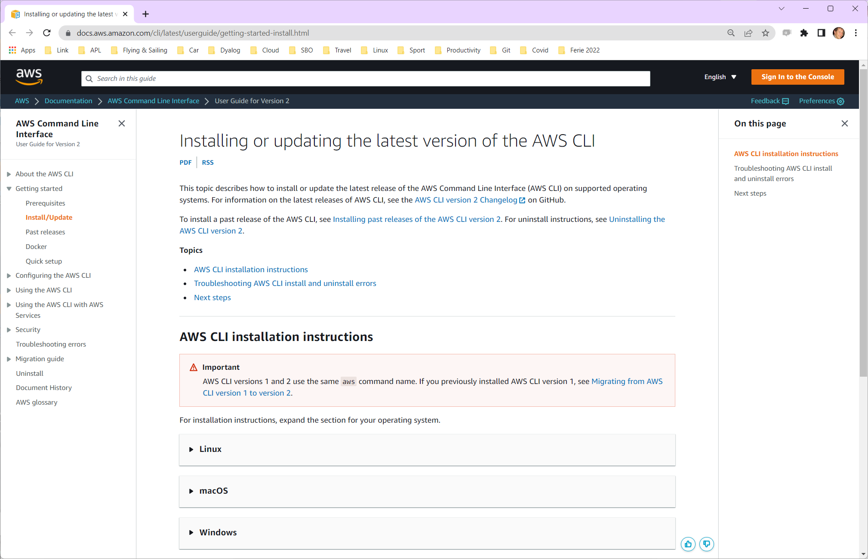

Slide 75
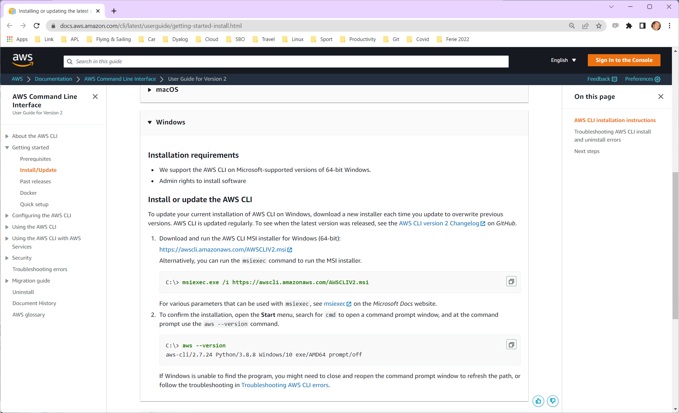

Slide 76
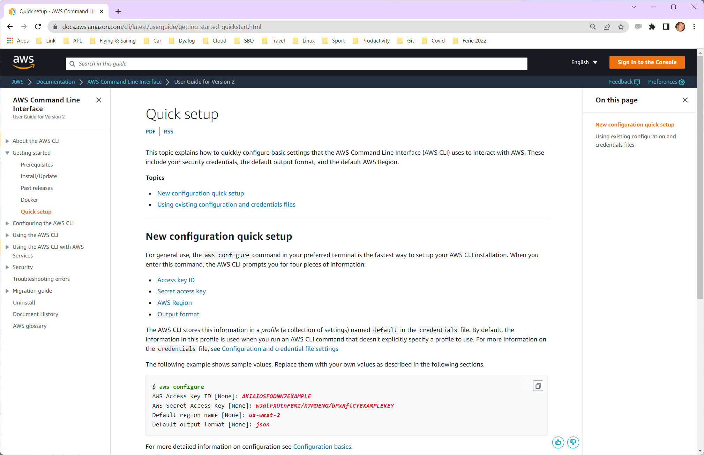
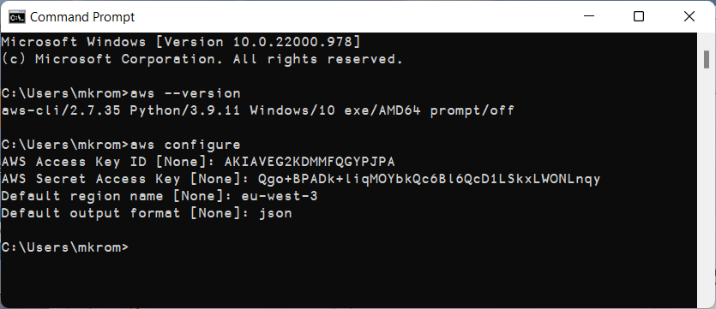

Slide 77
Docker ECS integration
Docker Compose can be connected to the Amazon Elastic Container Service
Integration also exists for Microsoft Azure and perhaps other providers
We need to create a "docker context"
When we select the ECS context, commands like "docker compose … up" will use ECS to run our containers

Slide 78
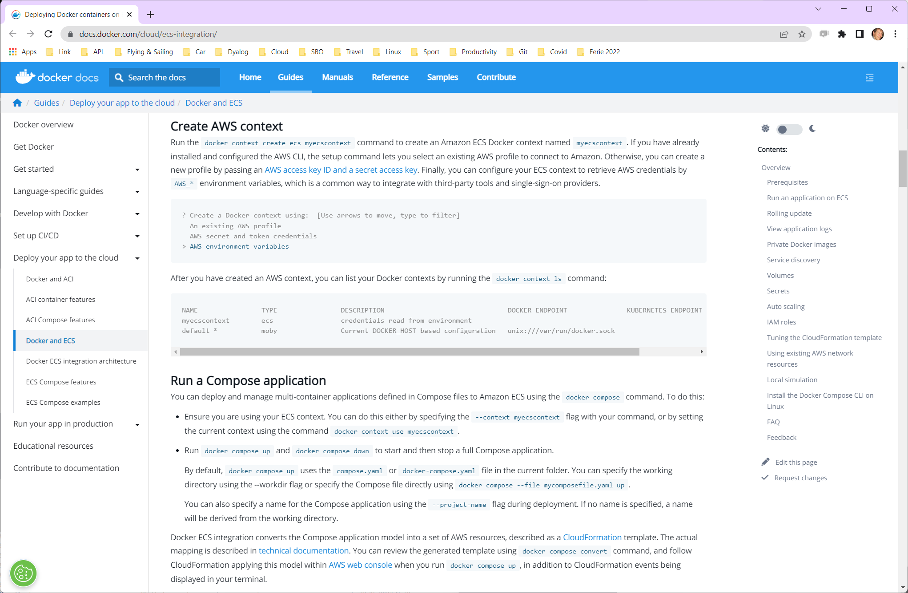

Slide 79
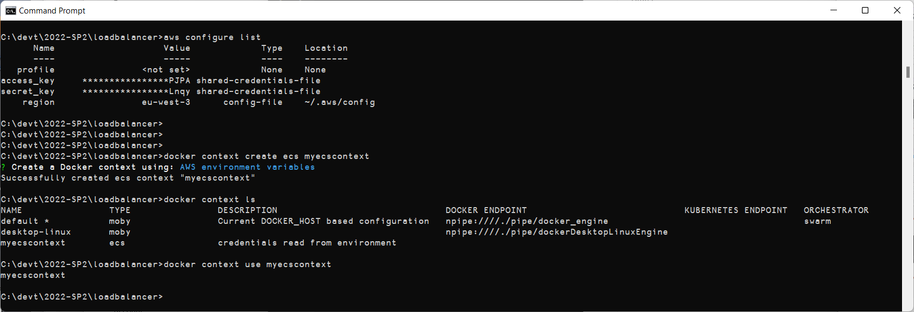
This folder was renamed as "two-tier"
Create ECS-based context
Switch to ECS-based context
Notes:
BPB screenshot to get folder name right?

Slide 80
Upload Image
In order to use our container from AWS we need to store it either in DockerHub or the Amazon Elastic Container Registry
Other registries exist but we have not tested them
We will use ECR since we already have a user id on AWS

Slide 81
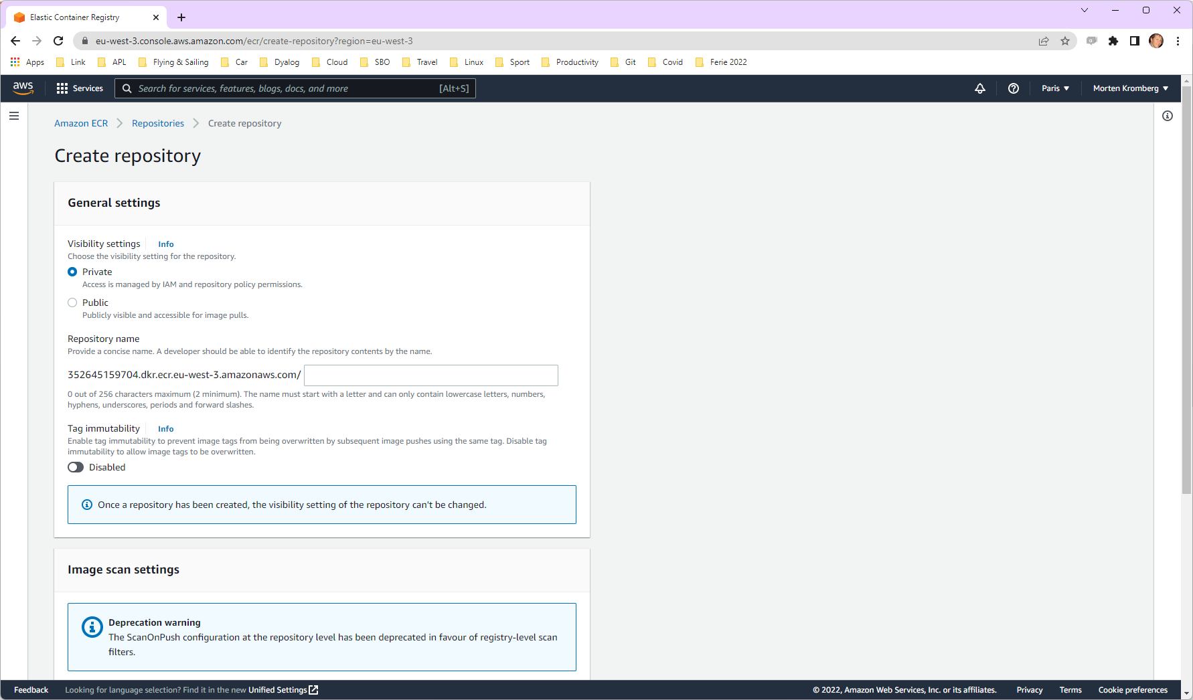
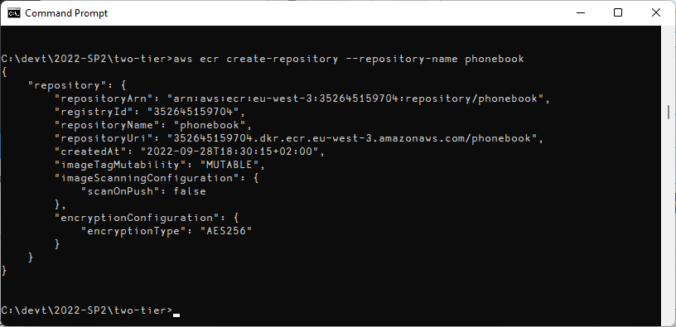
This is your user ID

Slide 82
Your user ID goes here
C:\devt\2022-SP2\two-tier>aws ecr get-login-password | docker login --username AWS --password-stdin 352645159704.dkr.ecr.eu-west-3.amazonaws.com
Login Succeeded
C:\devt\2022-SP2\two-tier>docker context use default
C:\devt\2022-SP2\two-tier>docker build –t phonebook .
C:\devt\2022-SP2\two-tier>docker tag phonebook 352645159704.dkr.ecr.eu-west-3.amazonaws.com/phonebook
C:\devt\2022-SP2\two-tier>docker push 352645159704.dkr.ecr.eu-west-3.amazonaws.com/phonebook
Using default tag: latest
The push refers to repository [352645159704.dkr.ecr.eu-west-3.amazonaws.com/phonebook]
5f70bf18a086: Pushed
56547f2ee3b0: Pushed
…blablabla…
eb0d9da5f23f: Pushed
09ebdb357ed5: Pushed
latest: digest: sha256:8e98fe2b7827ce2f1be123f567ca7be2d62985587228ddb4a390c5dfb02609e5 size: 3236
C:\devt\2022-SP2\two-tier>
(You can edit & run push.bat instead of typing the last command above)

Slide 83
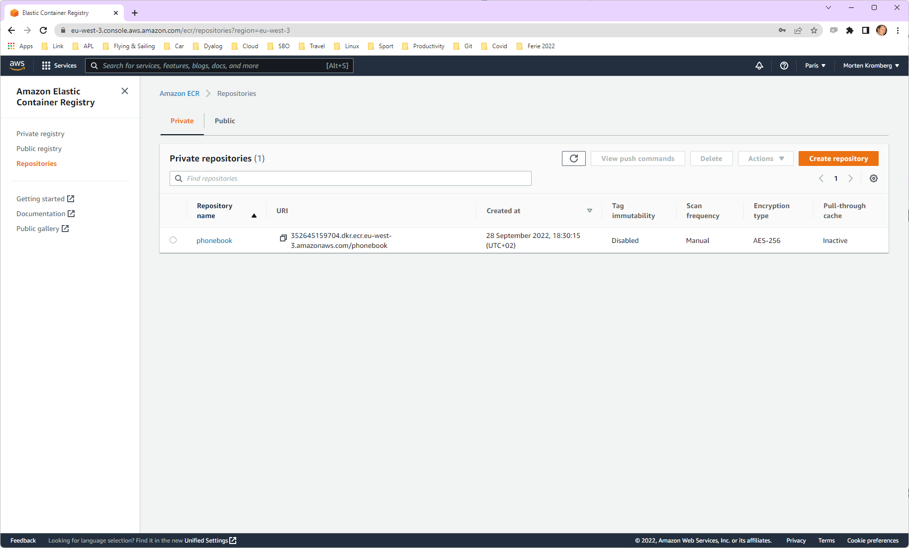

Slide 84
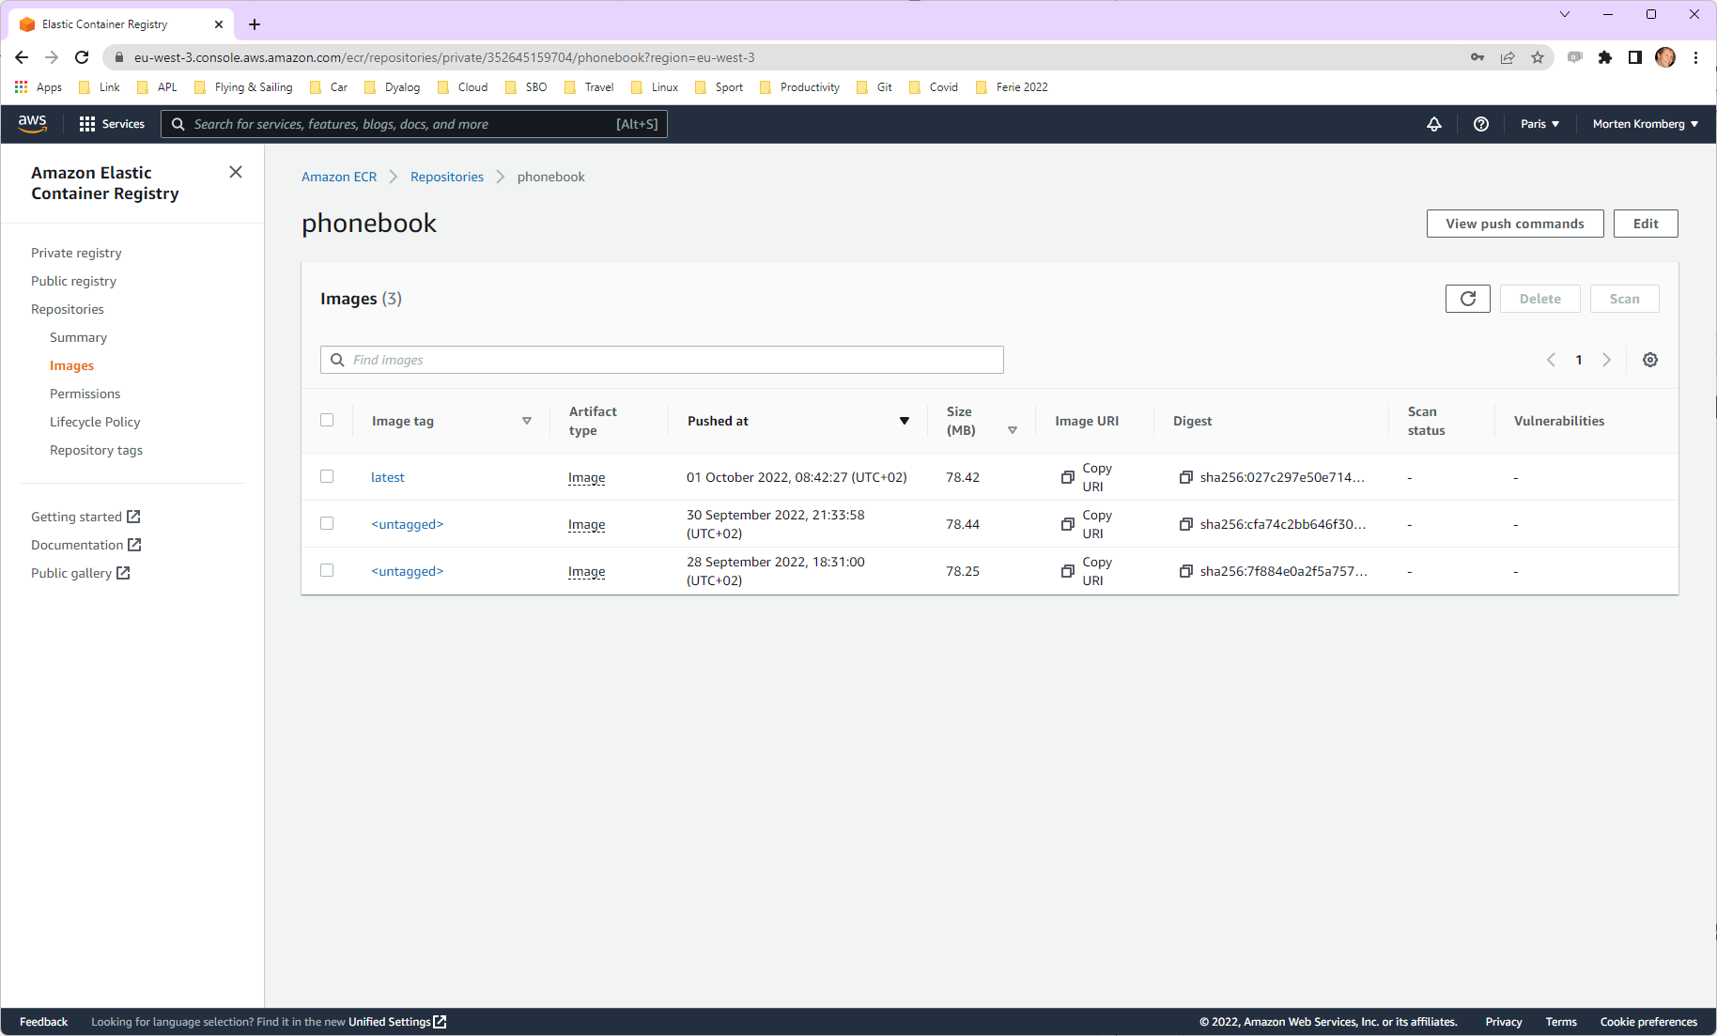

Slide 85
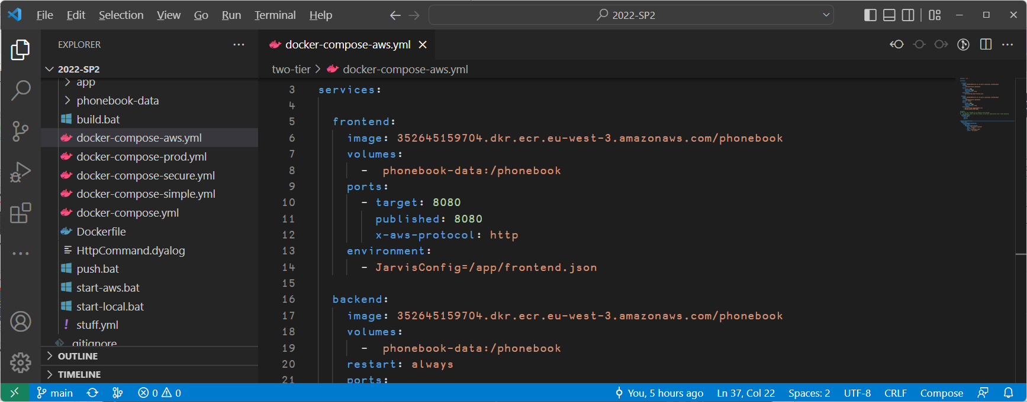
Ready for take-off?
Edit docker-compose-aws.yml
Edit image names to refer to YOUR image

Slide 86
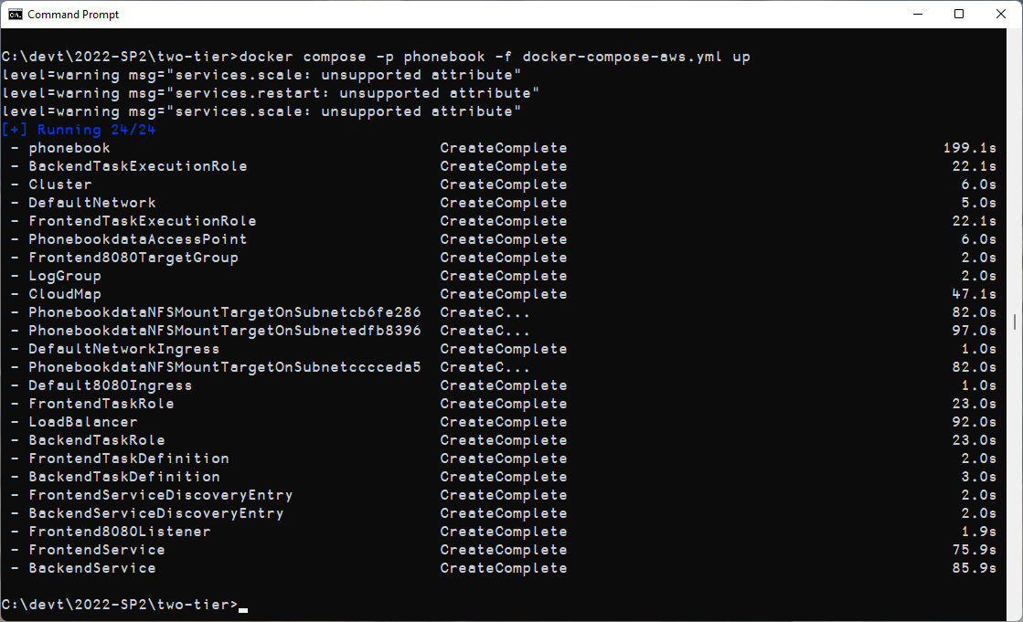
C:> docker context use phonebook C:> docker compose –p phonebook –f docker-compose-aws.yml up

Slide 87
So what just happened??!!
A "CloudFormation Stack" was created…
It contains "Elastic" components that reproduce the networking and process management that docker compose was doing locally

Slide 88
Load Balancer "phonebook" defines a collection of Listeners that direct to TargetGroups
Cluster contains the running tasks
FrontEnd8080Listener directs incoming traffic on port 8080 to the frontend TargetGroup
FrontEnd8080TargetGroup distributes traffic to tasks in the group (at the moment, only one, but wait…)
Frontend Task
Backend Task visible to frontend but not exposed to internet
Plus: CloudMap, DefaultNetwork, LogGroup, Roles, "Ingresses" for each Listener, "ServiceDiscoveryEntry" and "TaskExecutionRoles" for each TargetGroup, "NFSMountTargets" on each subnet in the region

Slide 89
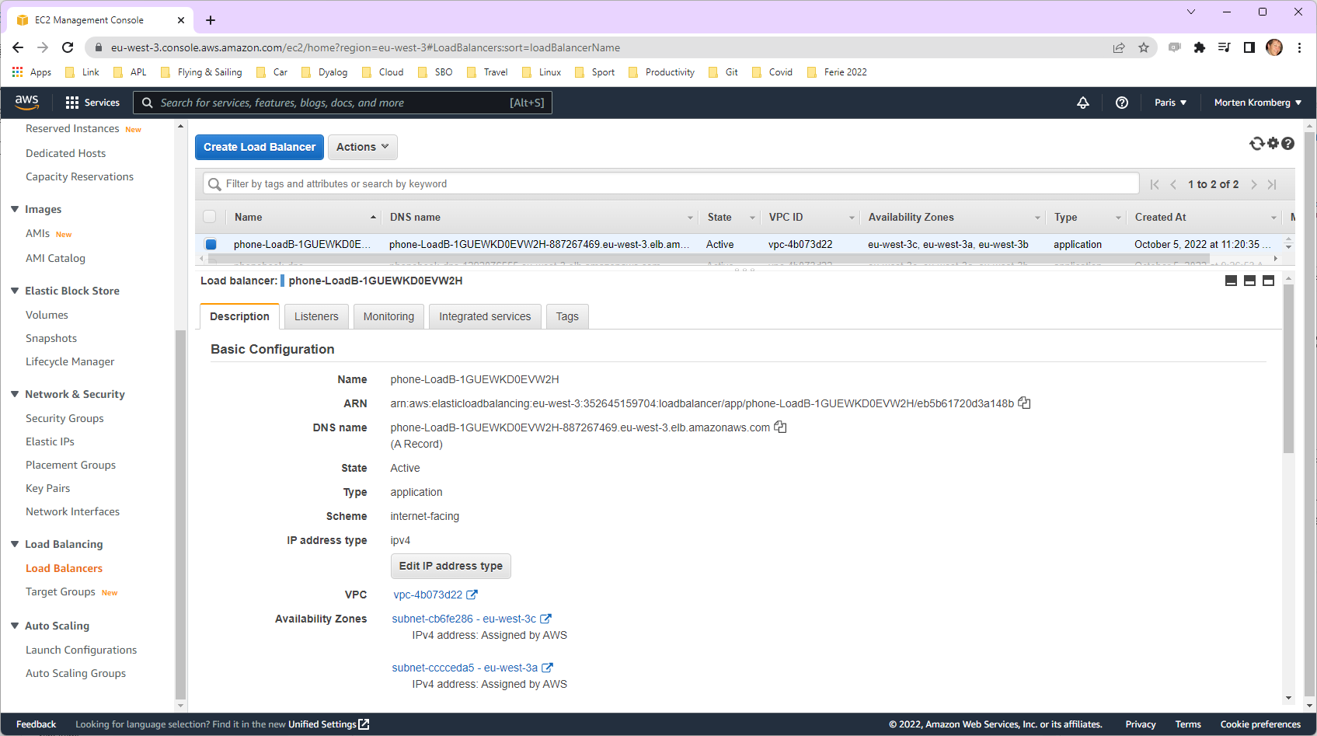

Slide 90
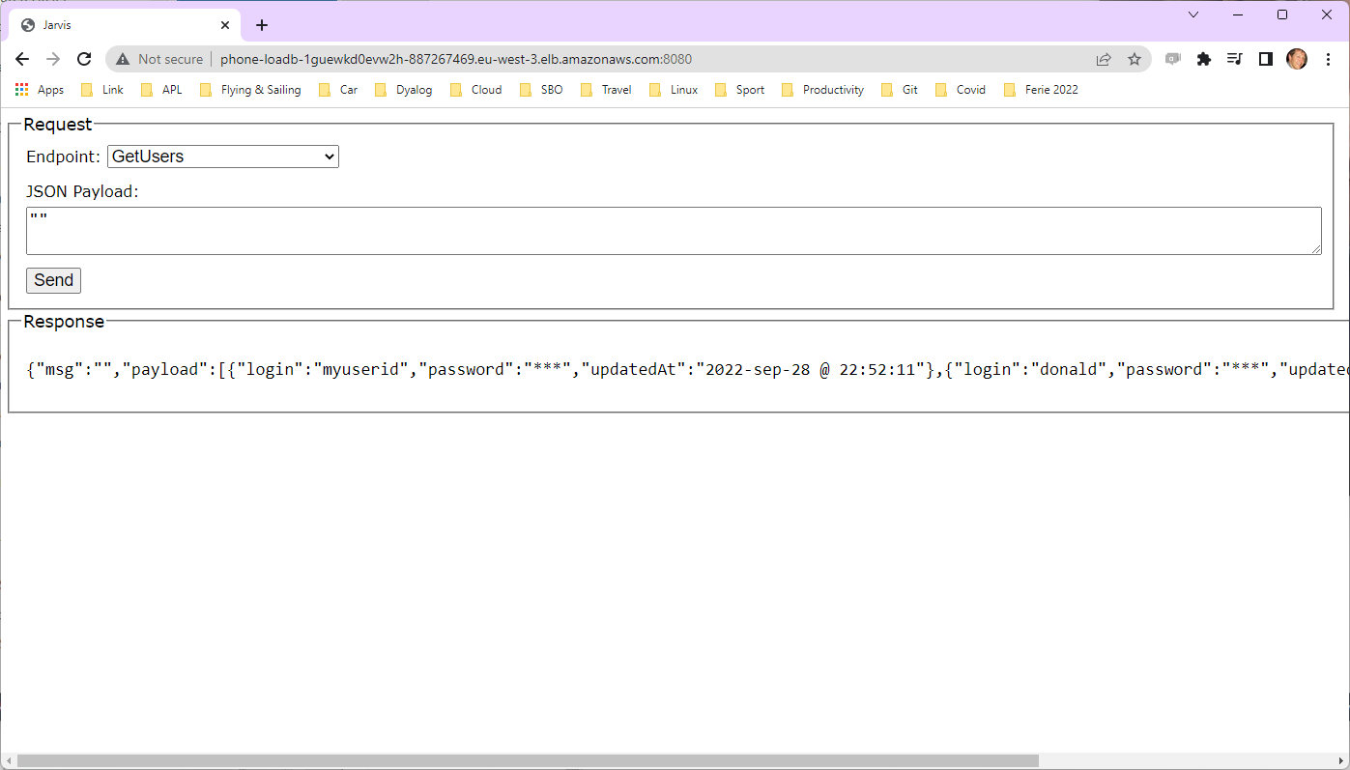

Slide 91
Let's take a look
(screen shots of selected artefacts)

Slide 92
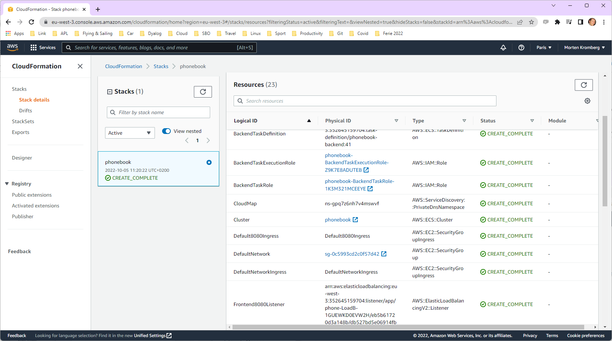

Slide 93
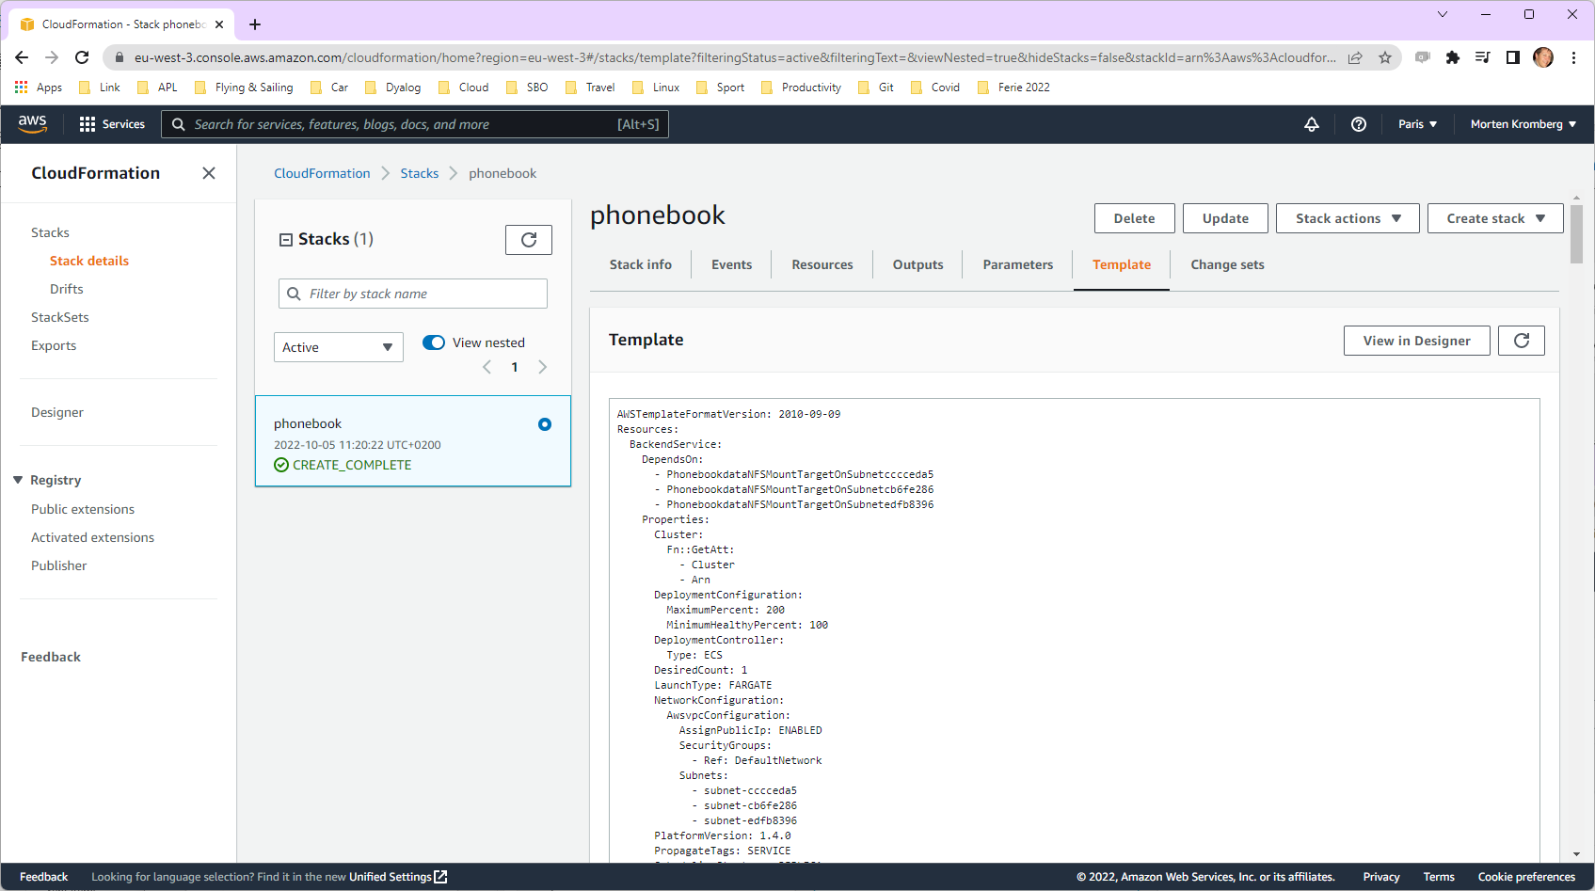

Slide 94
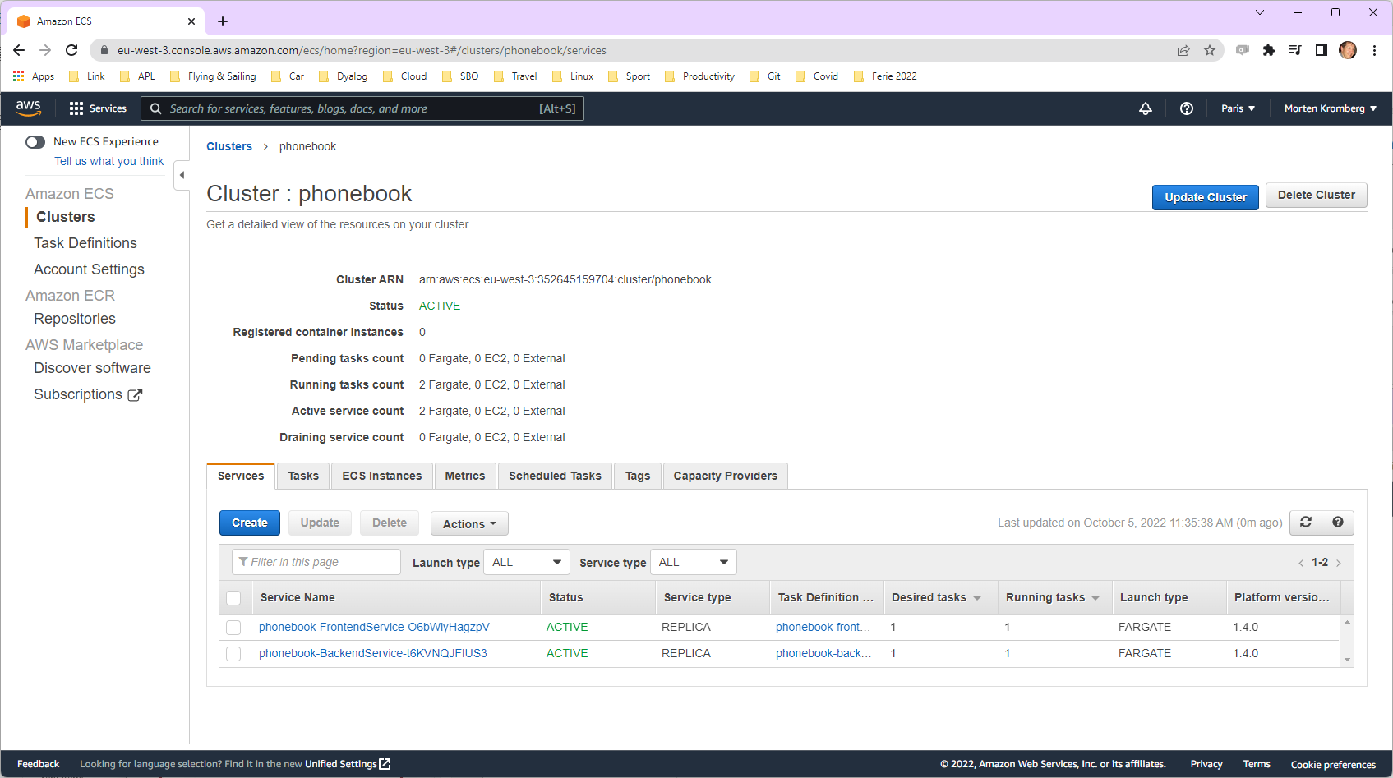

Slide 95
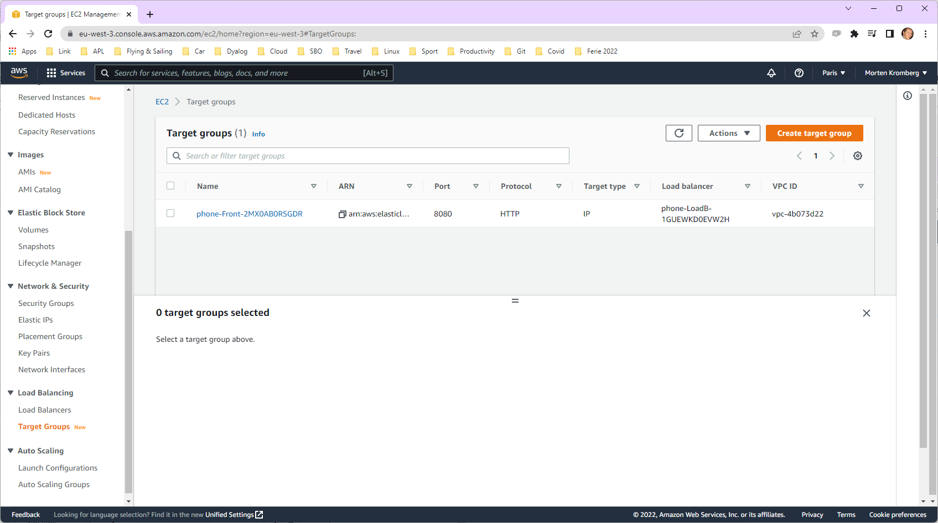

Slide 96
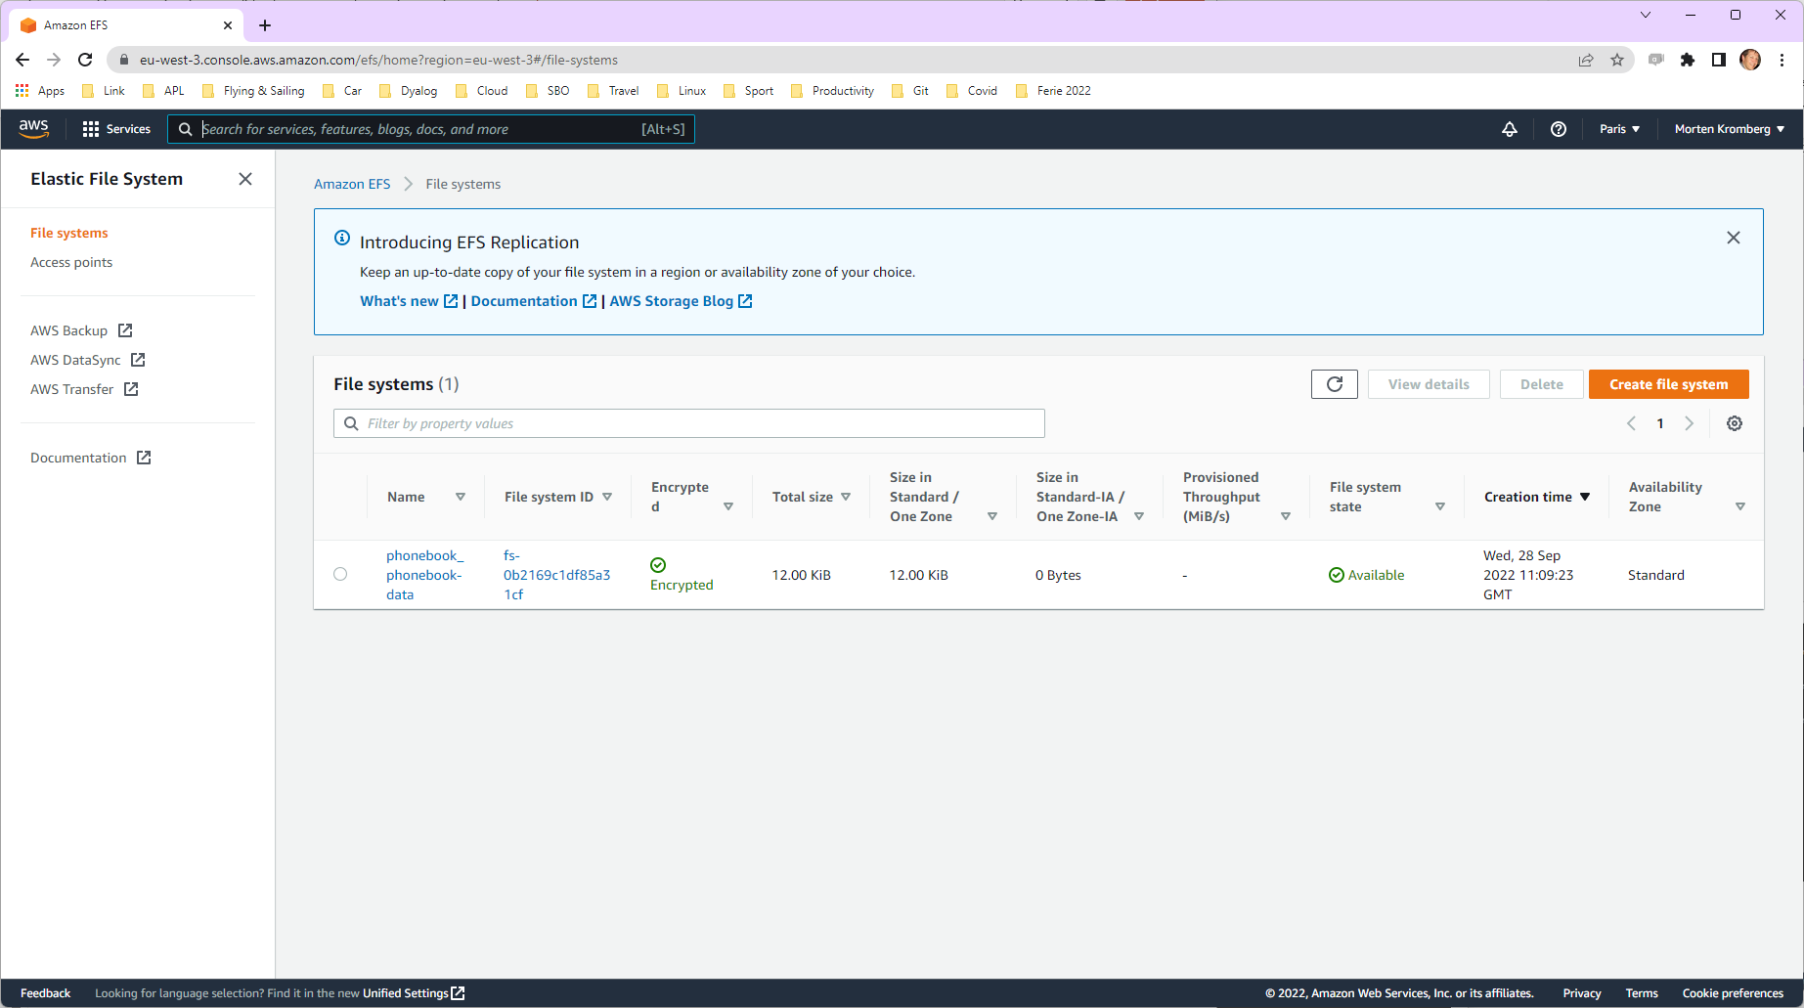
So what just happened?
Docker compose created
One "Load Balancer"
Two "Target Groups"
One "Cluster"
Two "Tasks"
One "Security Group"
An Elastic (what else) File System was automatically created due to the volumes: statement in the .yml file

Slide 97
We can see them all here…

Slide 98
docker compose … convert
docker compose … convert >file.yml
… will create the CloudFormation YML for you to view (and edit, once you do another week of reading)

Slide 99
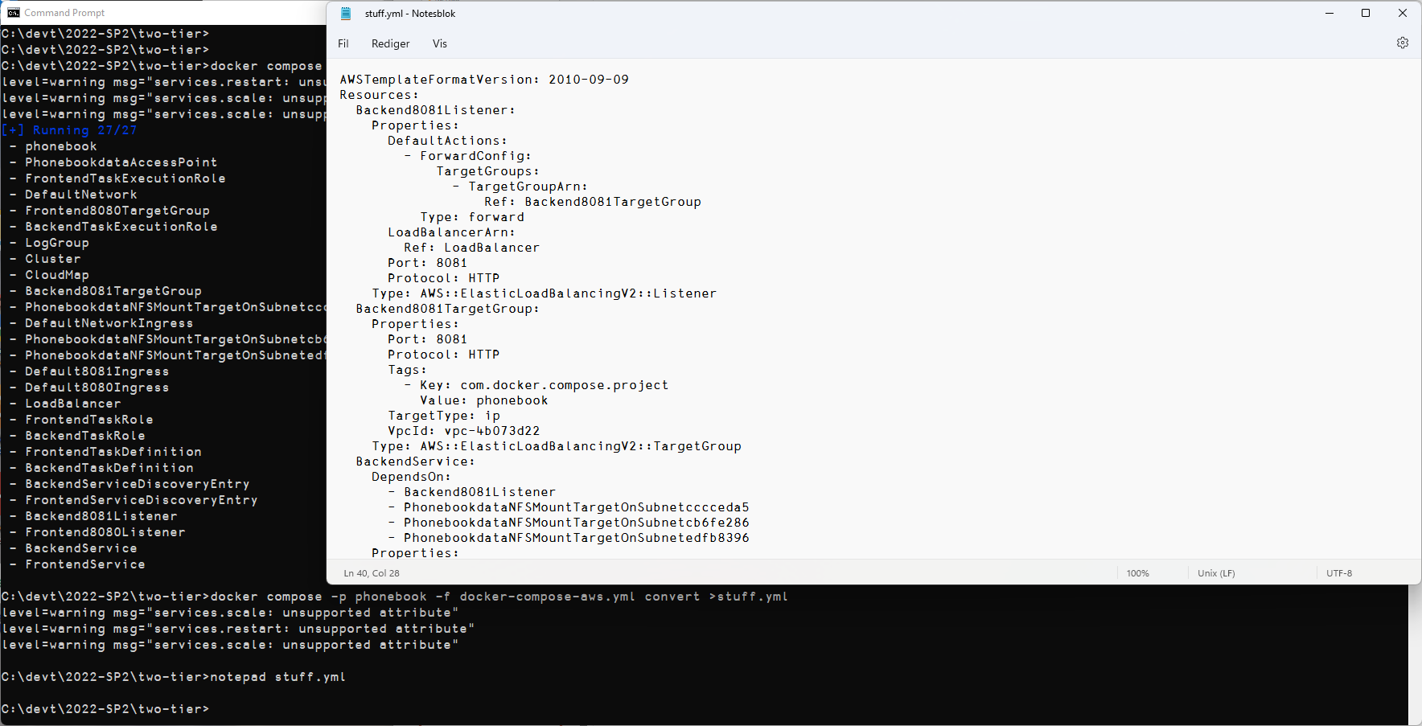

Slide 100
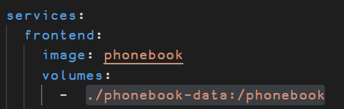
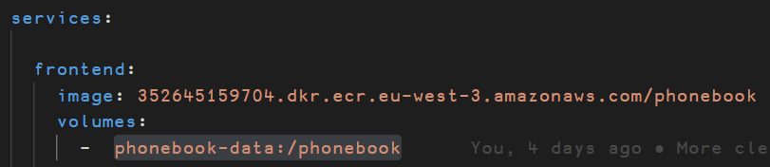
Tidying up a bit
So far, we have been using two YML files
docker-compose-local.yml
docker-compose-aws.yml
It would be easier to maintain a single YML file

Slide 101


One .YML File → two .BAT files

Slide 102


Notes:
BPB screenshot to update ports

Slide 103
CloudFormation "Overlays"
AWS ECS has features that docker-compose does not support directly
We can add "overlays" that will modify the CloudFormation before it is uploaded

Slide 104

This is not an overlay, but needed because volumes are created with root as user. This section states that we will access the file system as if we were user 0 (root).
Make load balancing "sticky": direct all requests from same client to the same server process. (Uses cookies, allows some server-side state)
The interpreter does not respond to "Health Checks" on the RIDE port, so the backend will be recucled after (3×30=90) seconds unless we add this

Slide 105
Using your own Domain Name
At the moment, everything is re-created on each "docker compose … up"
The DNS address is different each time
To resolve this, we must use the same "Load Balancer" each time
If we create a load balancer, we can instruct docker compose to use it…

Slide 106


Creating a Permanent Load Balancer

Slide 107

"Uncomment" this line

Slide 108


Slide 109
Scaling the Frontend
The --scale switch instructs docker compose to run a specific number of copies of a service
The docker compose command can be repeated to change the scale while the system is running

Slide 110
Load Balancer "phonebook" defines a collection of Listeners that direct to TargetGroups
Cluster contains the running tasks
FrontEnd8080Listener directs incoming traffic on port 8080 to the frontend TargetGroup
FrontEnd8080TargetGroup distributes traffic to tasks in the group (actual "Load Balancing")
Frontend Task 1
Frontend Task 2 two identical processes
Backend Task 1 visible to frontends not exposed to internet
Plus: CloudMap, DefaultNetwork, LogGroup, Roles, "Ingresses" for each Listener, "ServiceDiscoveryEntry" and "TaskExecutionRoles" for each TargetGroup, "NFSMountTargets" on each subnet in the region

Slide 111
Load balance it
"The Cloud" (AWS)
Database
Docker Container
Jarvis
Read Operations
Load Balancer
App
Docker Container
Write Operations
Jarvis
App
Docker Container
Jarvis
Docker Container
App
Jarvis
App

Slide 112
Sticky Sessions
Remember that, thanks to the sticky session overlay, each client will always be directed to the same frontend process

Slide 113
Set up Domain Redirection
So, now our address is the same each time, but http://phone-loadb-1guewkd0evw2h-887267469.eu-west-3.elb.amazonaws.com …is a bit of a mouthful
How about phonebook.myco.com?
This requires you to register your own domain, and have an ISP that allows you to do redirection
Morten is using one.com

Slide 114

Define a Redirection
Time To Live tells DNS how long to cache the value before requesting a new one. 10 mins is minimum at one.com

Slide 115


Slide 116

One Final Challenge

Slide 117
Secure it
"The Cloud" (AWS)
Database
Docker Container
Jarvis
Read Operations
Load Balancer
App
Docker Container
Write Operations
Jarvis
App
Docker Container
Jarvis
Docker Container
App
Jarvis
App

Slide 118
Securing the Service
Steps:
Get hold of a certificate
We will get one from the AWS Certificate Manager
ACM will ask us to add another CNAME redirection and test it to verify that we are in control of the domain
Finally, we must add a listener on port 443 which redirects to 8080 (the frontend)

Slide 119


Slide 120


Slide 121


Slide 122



Slide 123


Slide 124


Slide 125


Slide 126


Slide 127



Slide 128



Slide 129


Slide 130



Slide 131
Loose Ends
Secure Service Setup:
Did not complete automation of startup of secure service – manual steps required
We will figure out how to do it and post updates (there will be a pod cast series)
Note that the manual setup requires manual teardown

Slide 132

Issues
Did not complete automation of secure setup.
Manual setup requires manual teardown
Not 100% stable

Slide 133
Goals
Give a quick introduction to:
Jarvis – Dyalog's Web Service Framework – to expose APL functions as services
Docker: to create lightweight Virtual Machines known as "Containers"
Docker Compose: to launch and manage multiple inter-connected containers
Amazon Web Services "Elastic Container Service": to allow Docker Compose to launch containers directly to the cloud (so-called "serverless" deployment)
How to scale the system by running multiple copies of selected services
How to assign your own domain name and a certificate to your service

